Slide 1
Publicly Available Data
Lauren Vanderlinden
BIOS 6660
Spring 2019

Slide 2
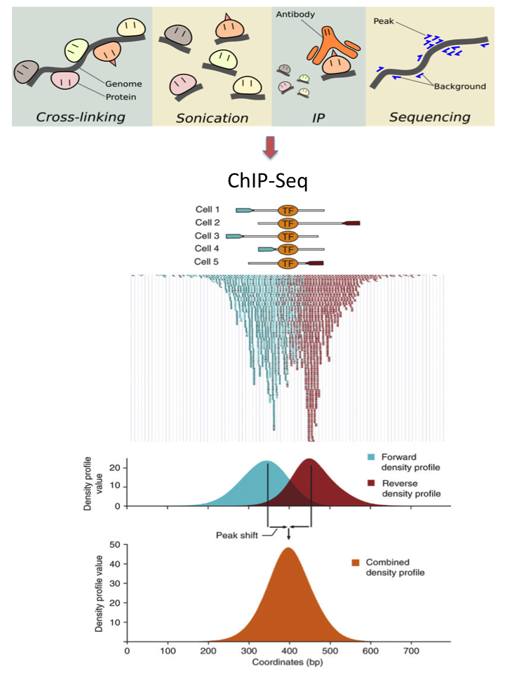
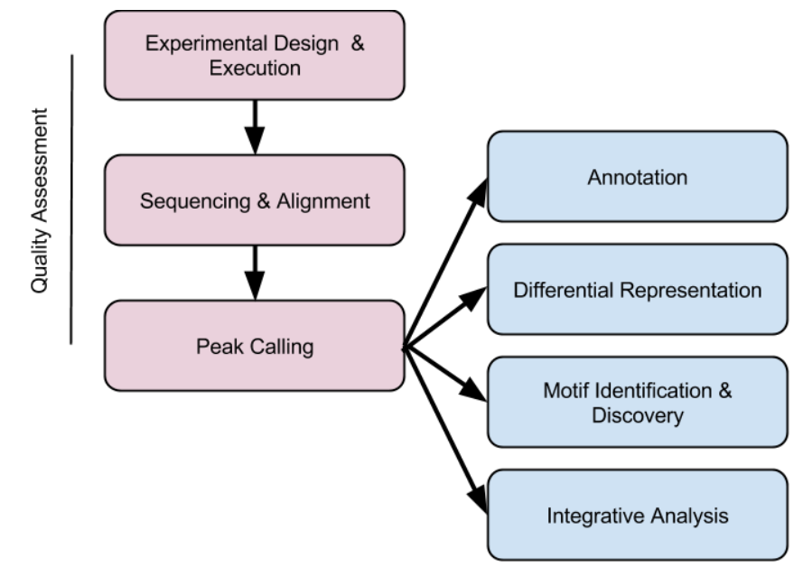
Overview From Last Time
Have wrapped up ChIP-Seq Analysis

Slide 3
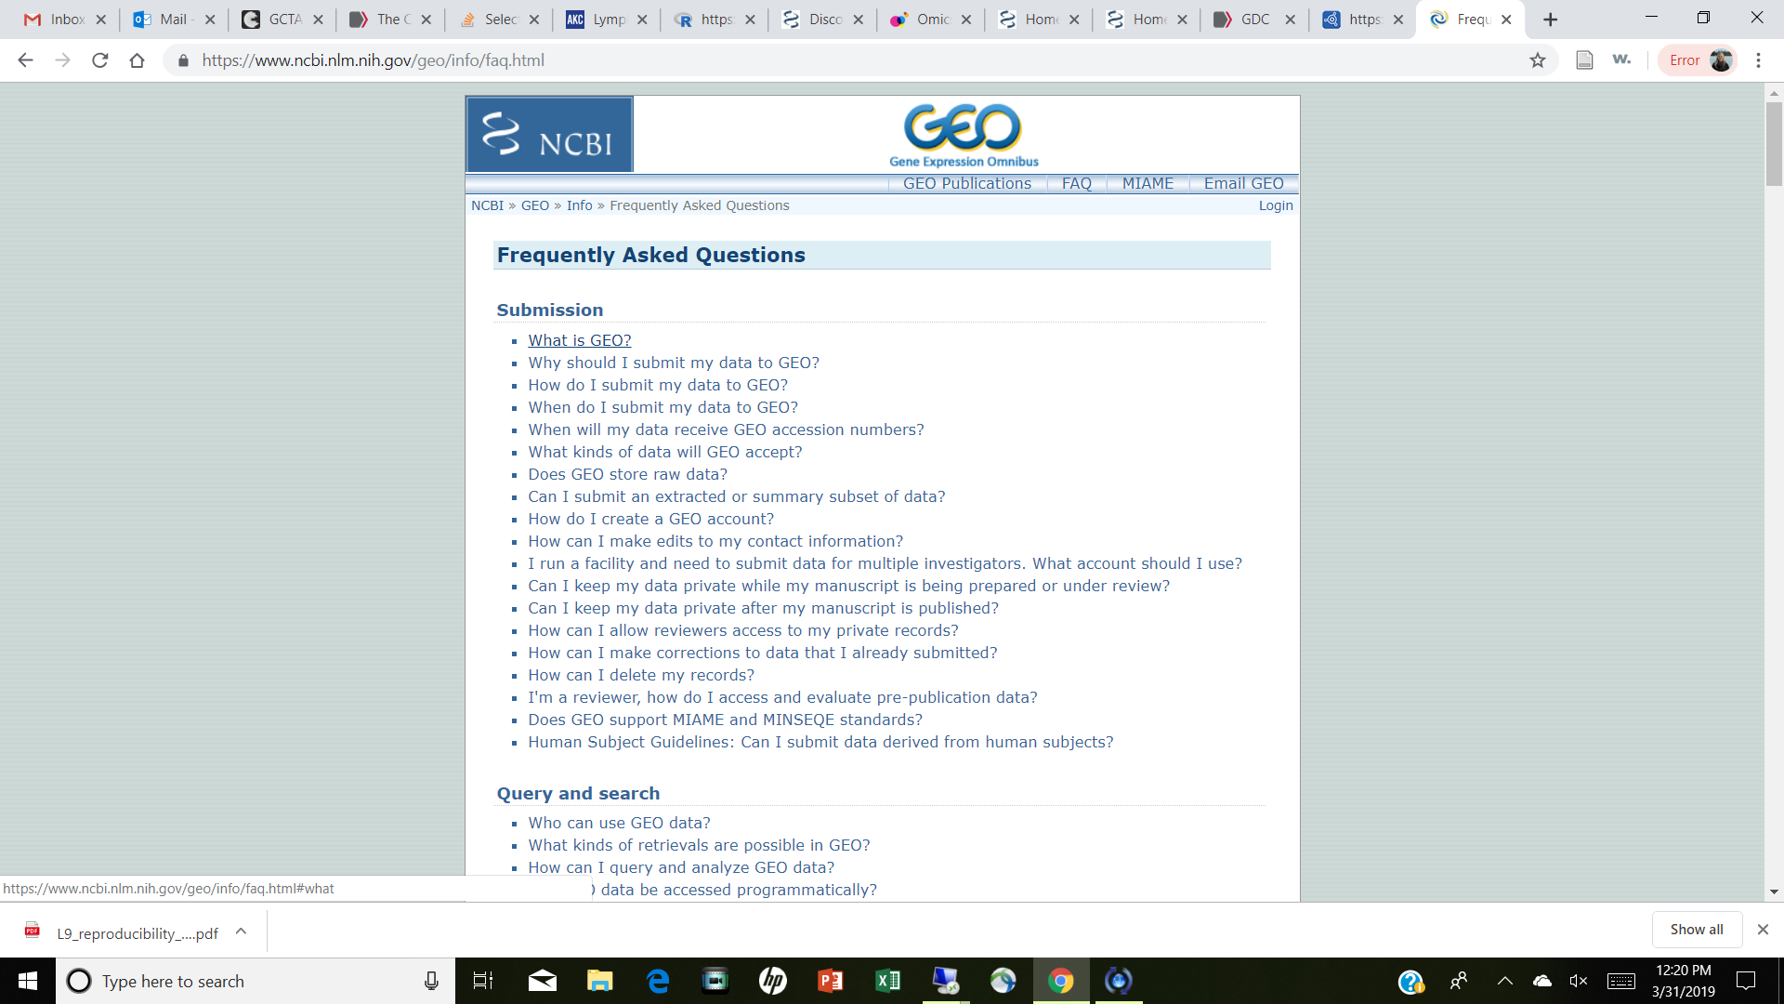
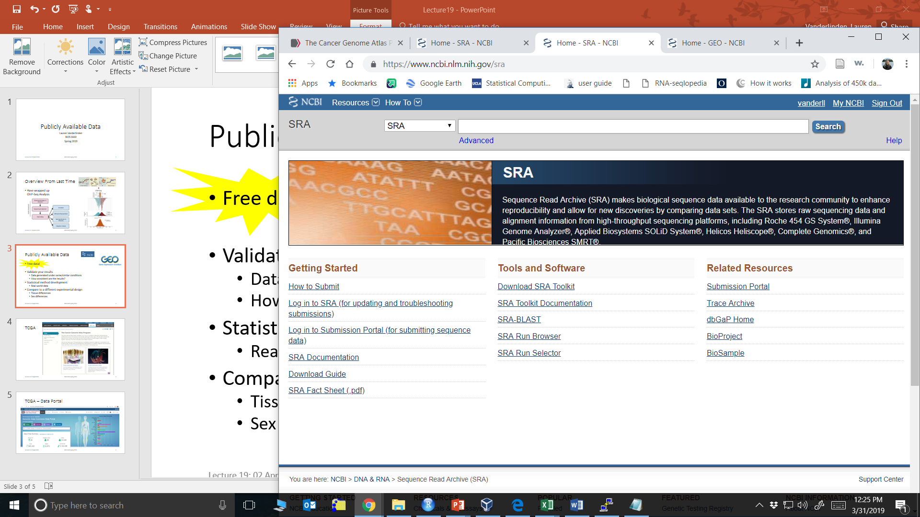



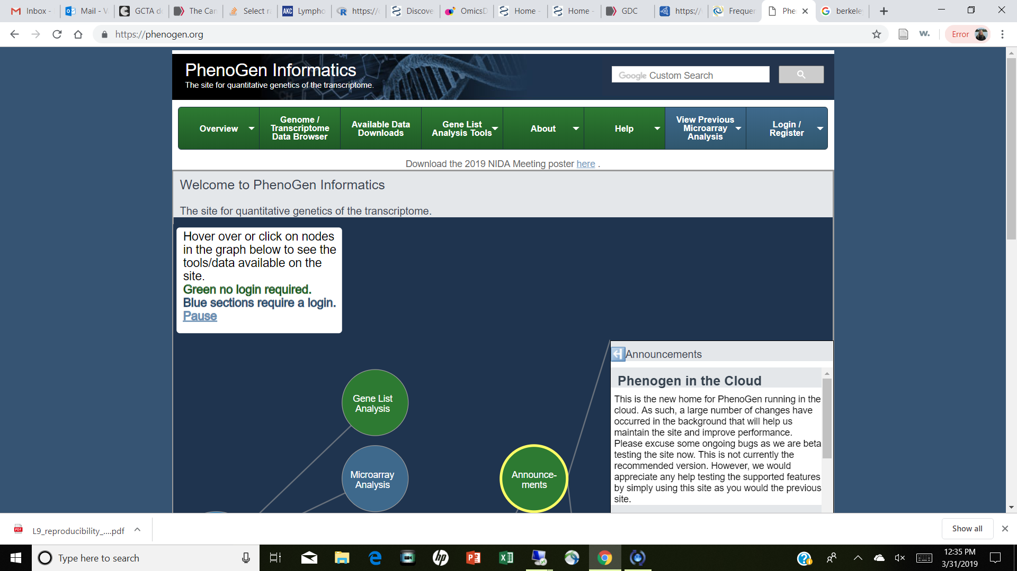
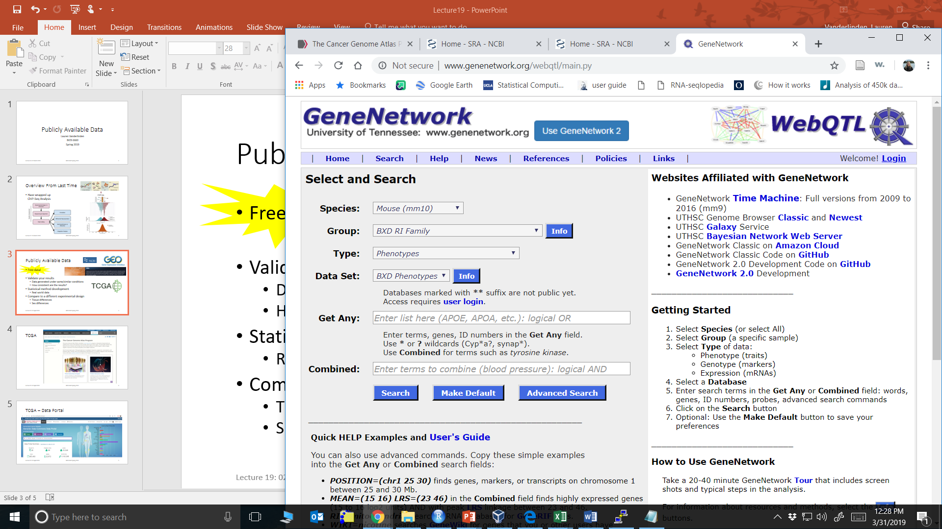
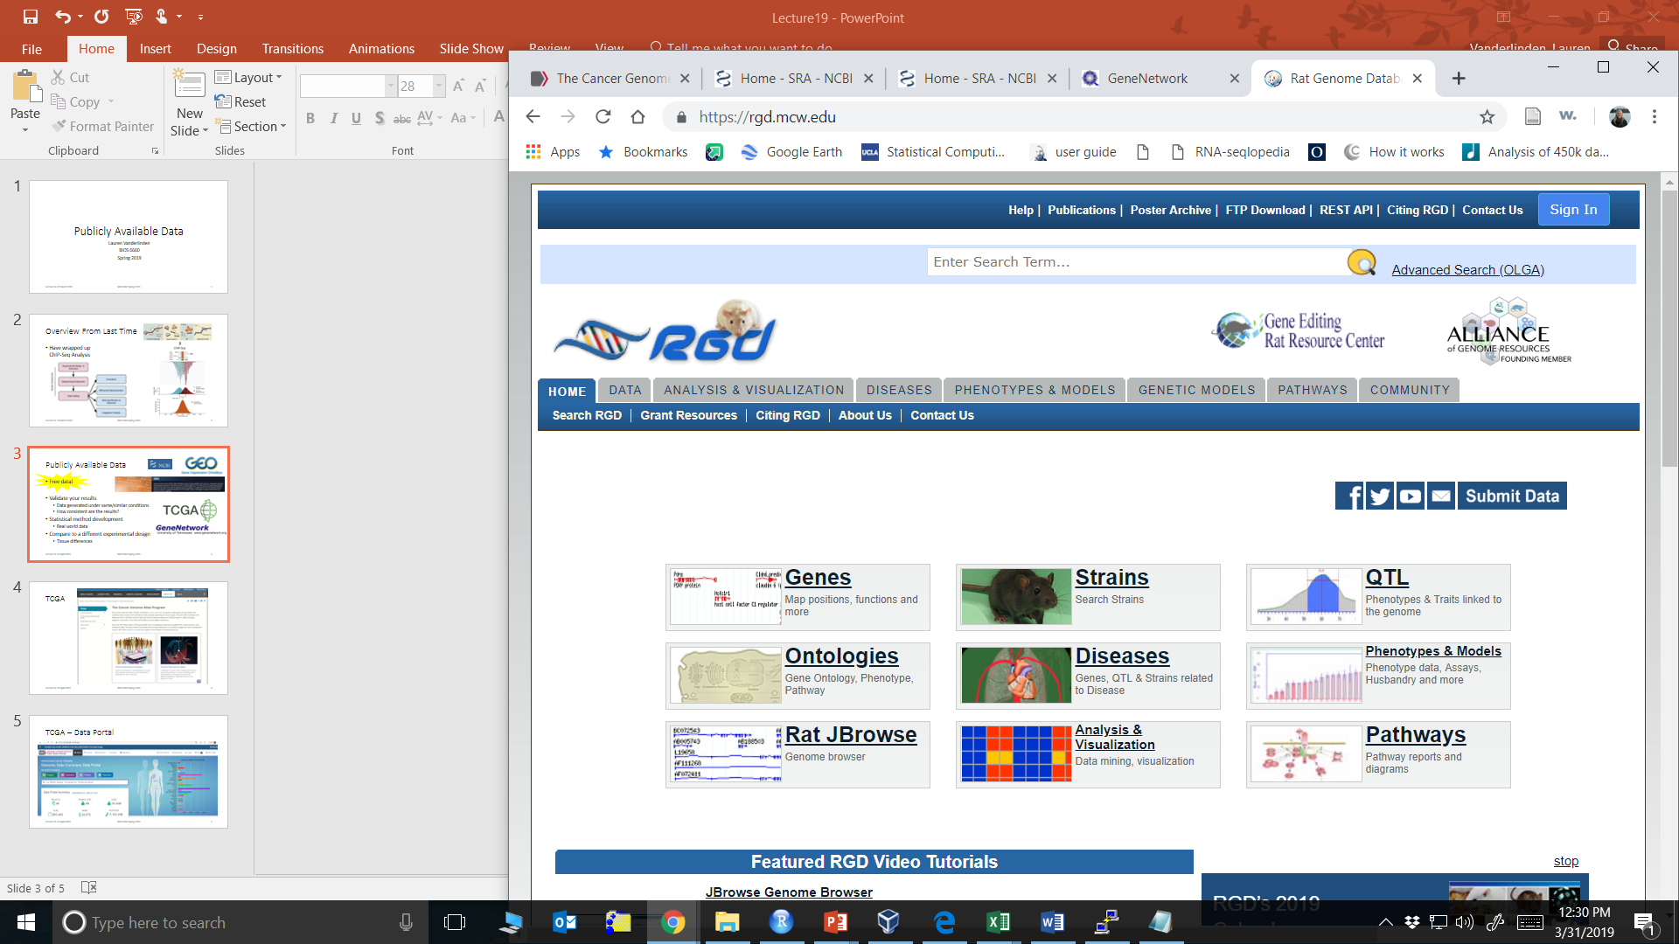
Publicly Available Data
Free data!
Validate your results
Data generated under same/similar conditions
How consistent are the results?
Statistical method development
Real world data
Compare to a different experimental design
Tissue differences

Slide 4
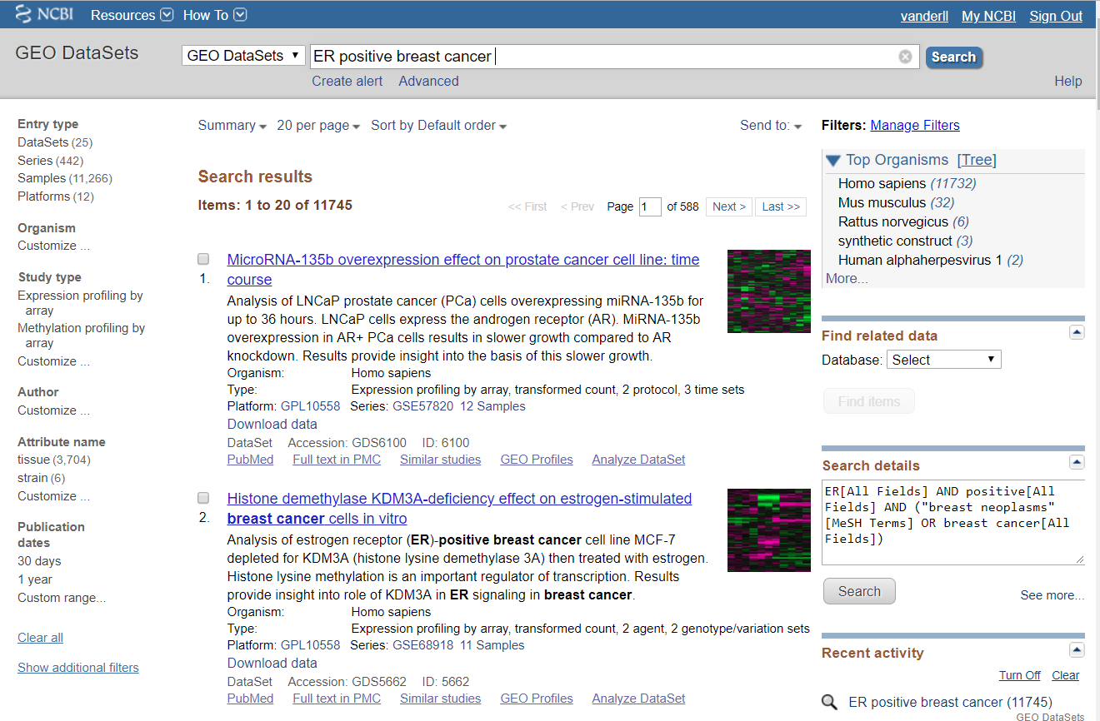
GEO Database
NCBI Gene Expression Omnibus
Microarray database
mRNA arrays
Methylation arrays
SNP arrays
miRNA arrays
Query like a literature search

Slide 5
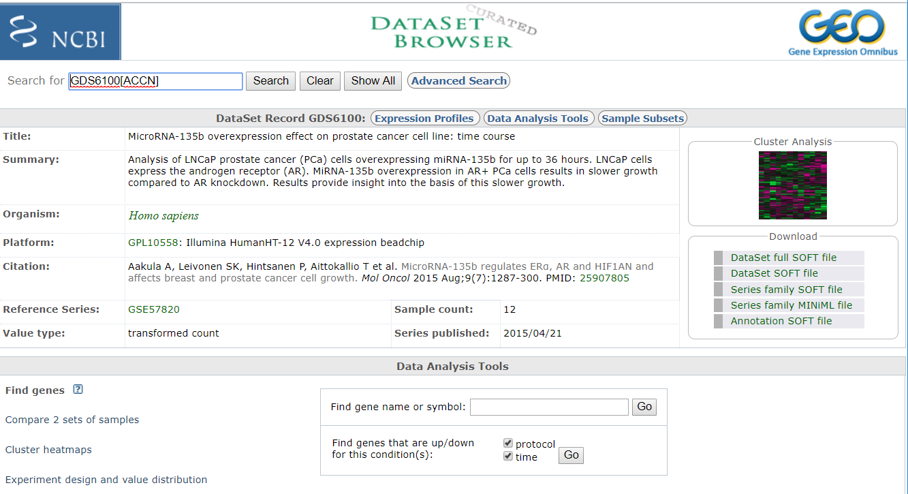
GEO Datasets – Selected Title
GSM: Sample level
GDS: Dataset
GSE: Series
GPL: Platform

Slide 6
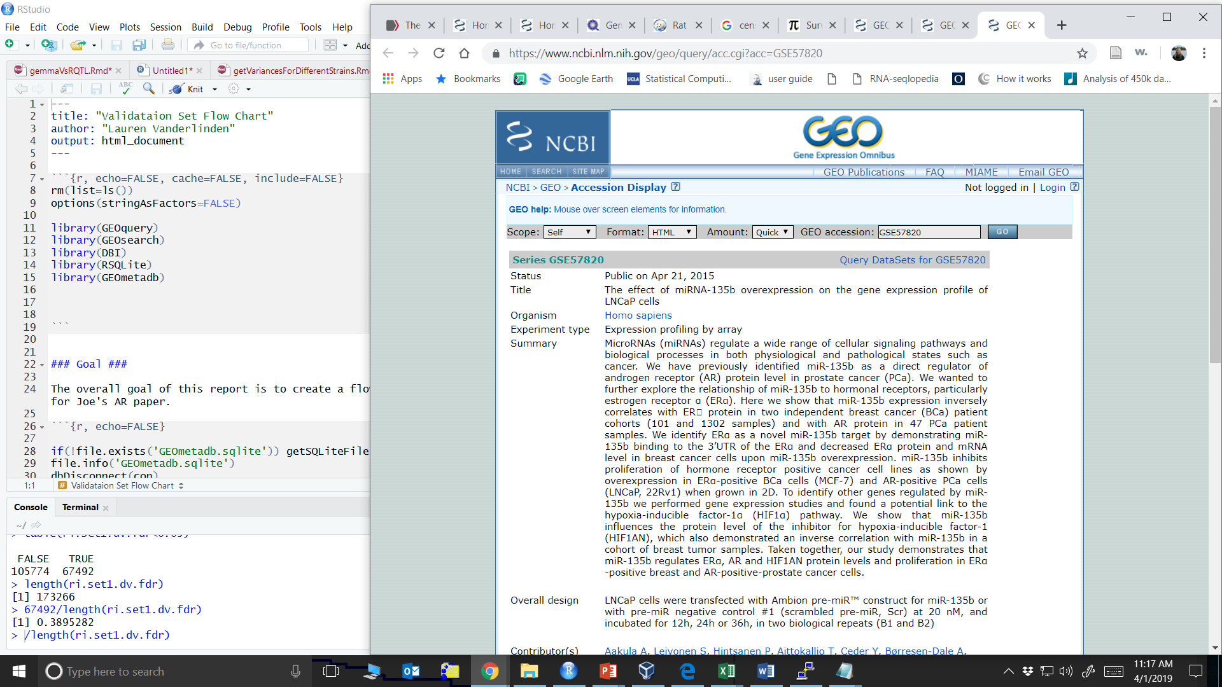
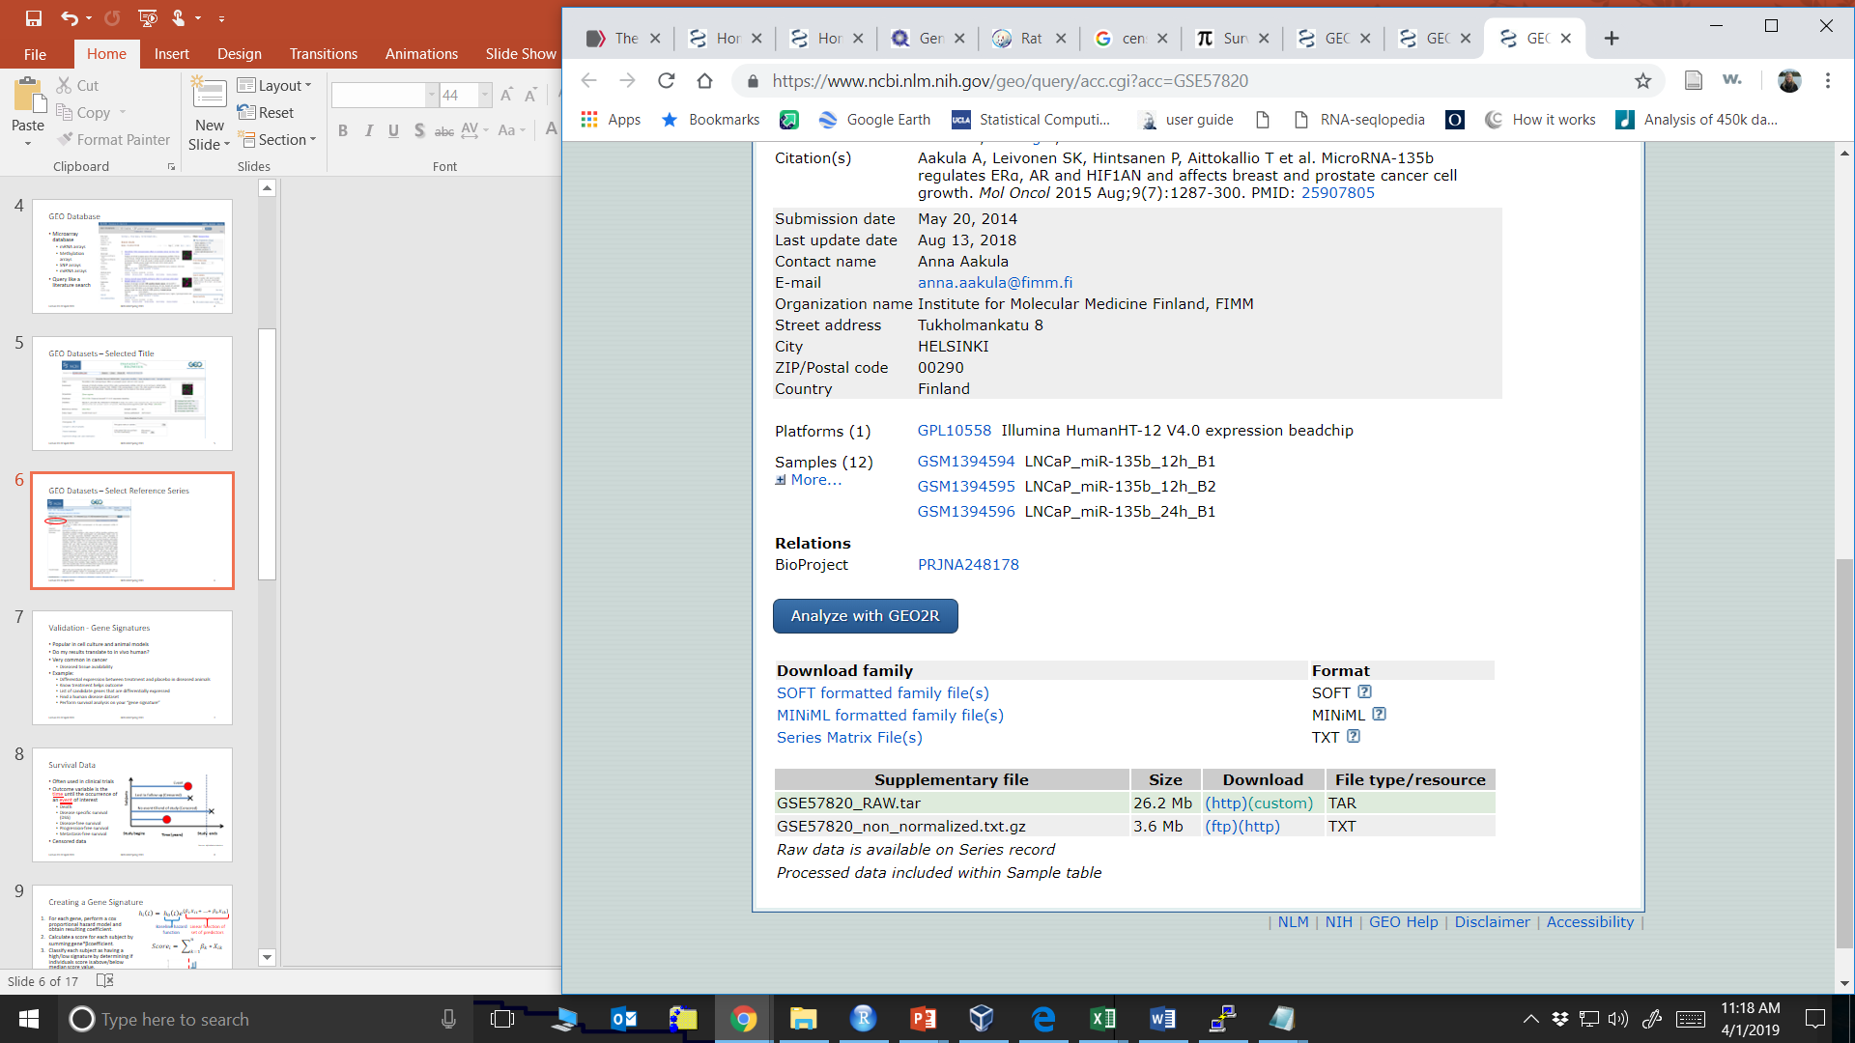
GEO Datasets – Select Reference Series
SOFT: Simple Omnibus Format in Text
Has both array data and meta data

Slide 7
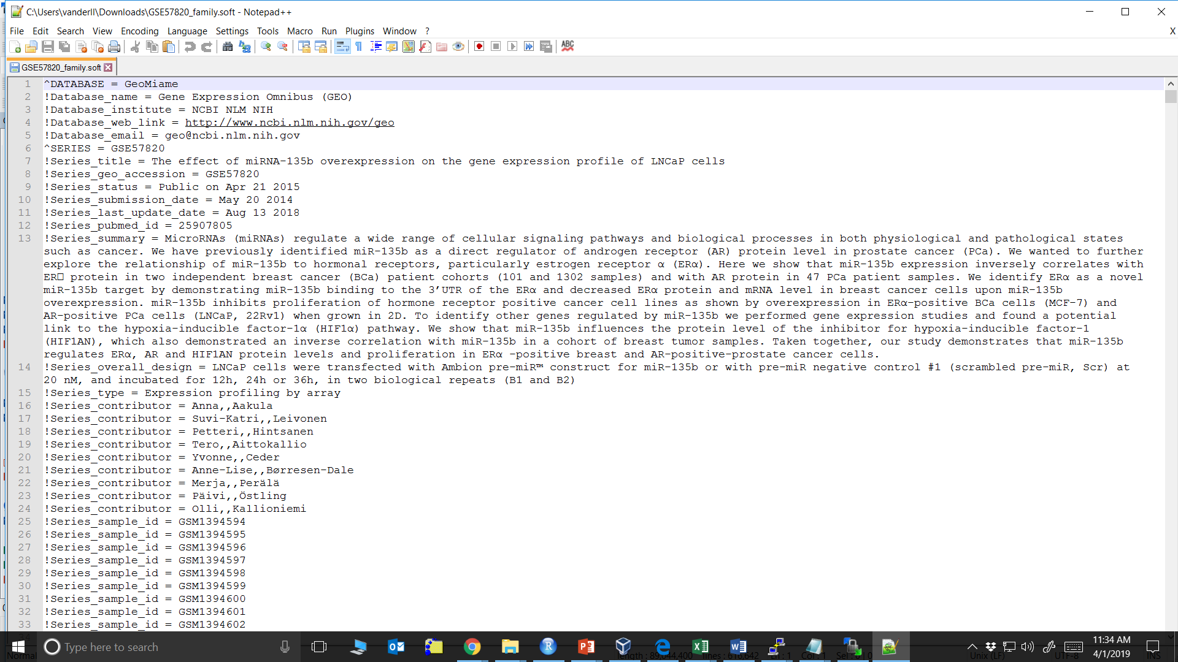
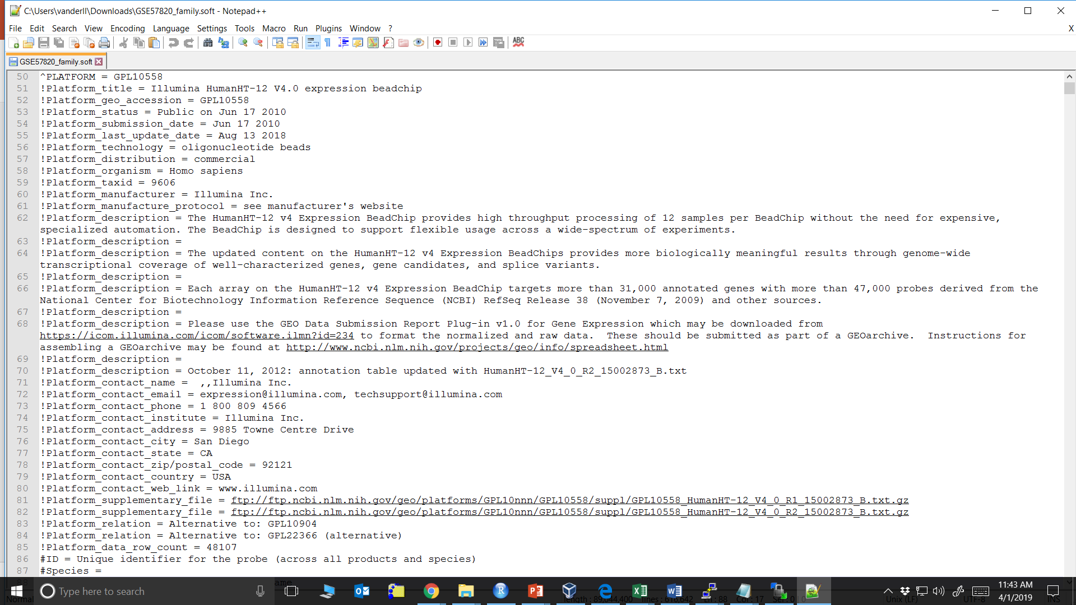
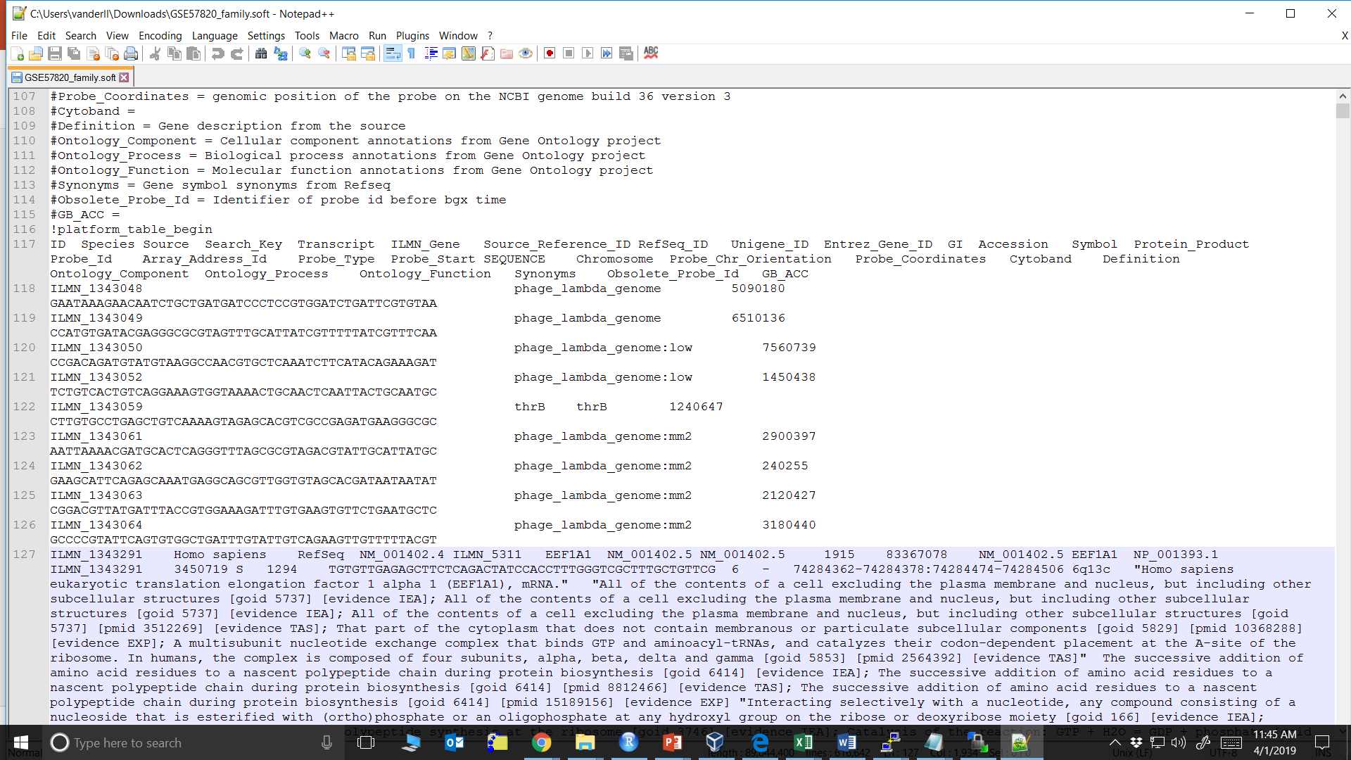
SOFT Dataset

Slide 8
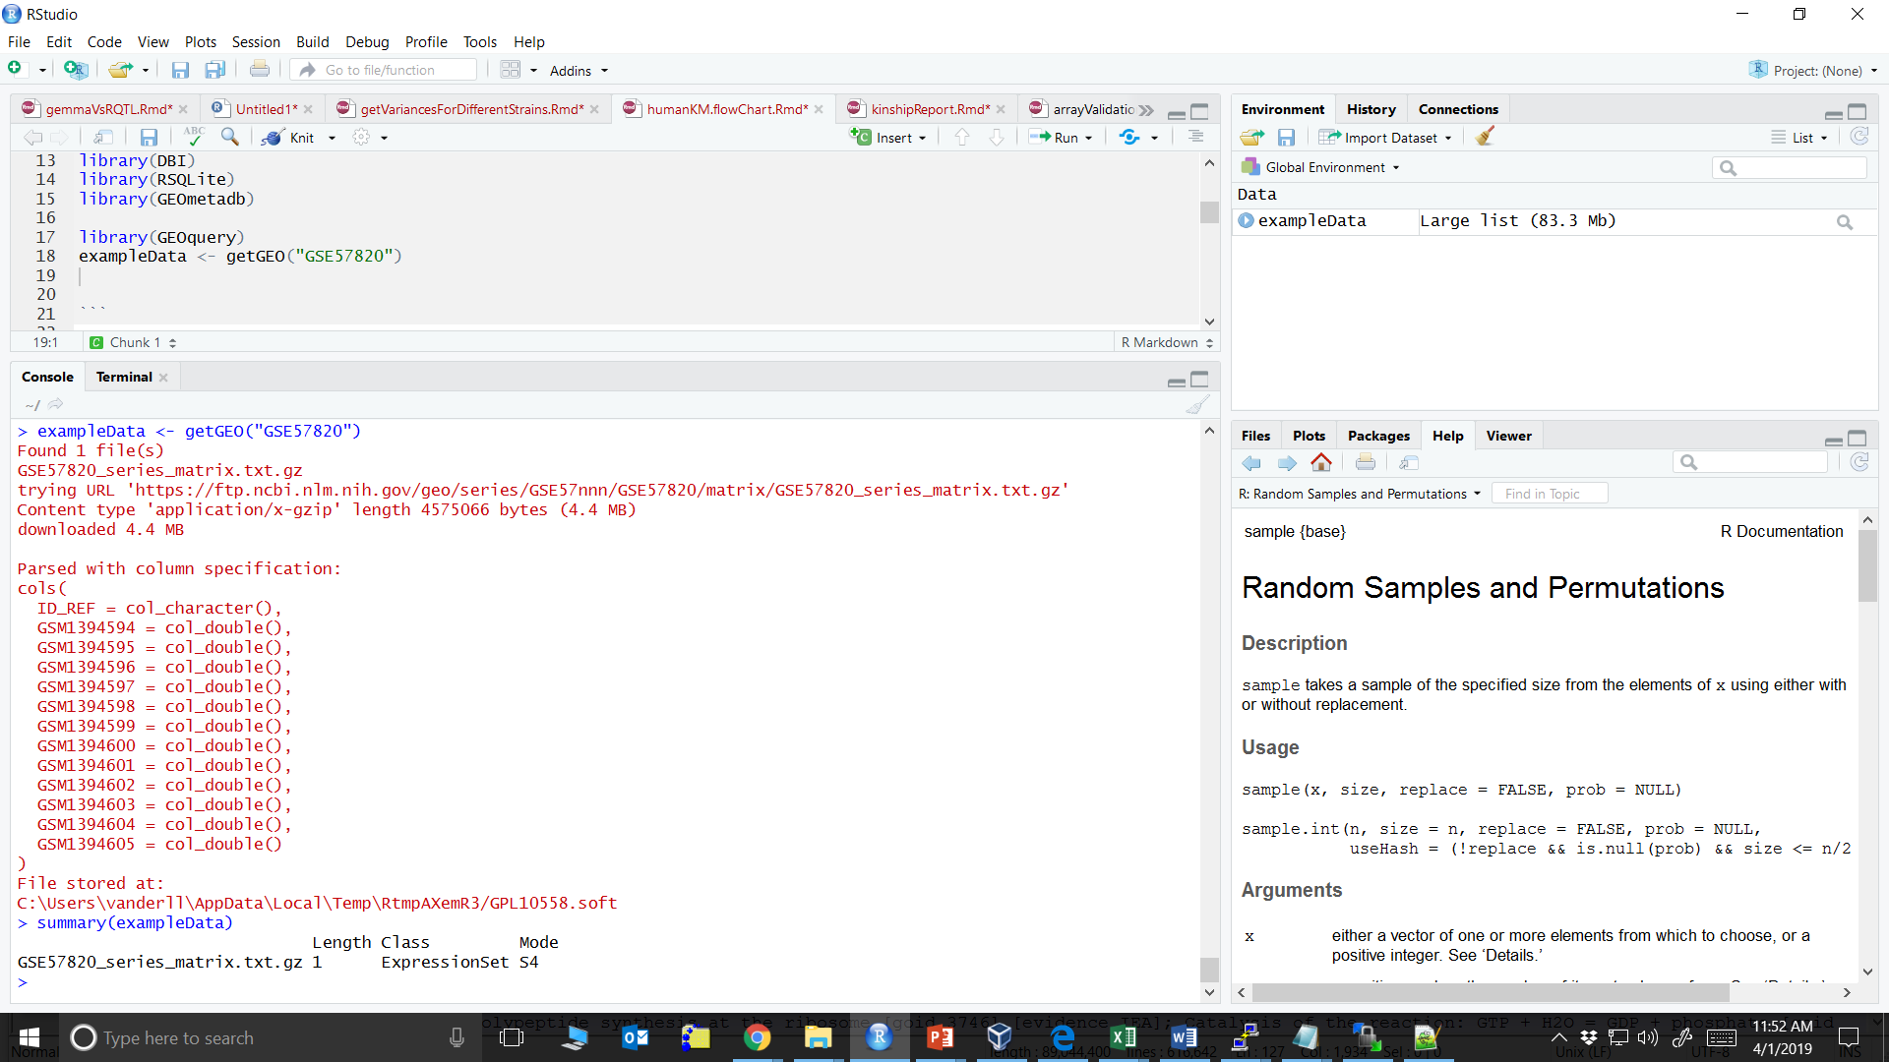
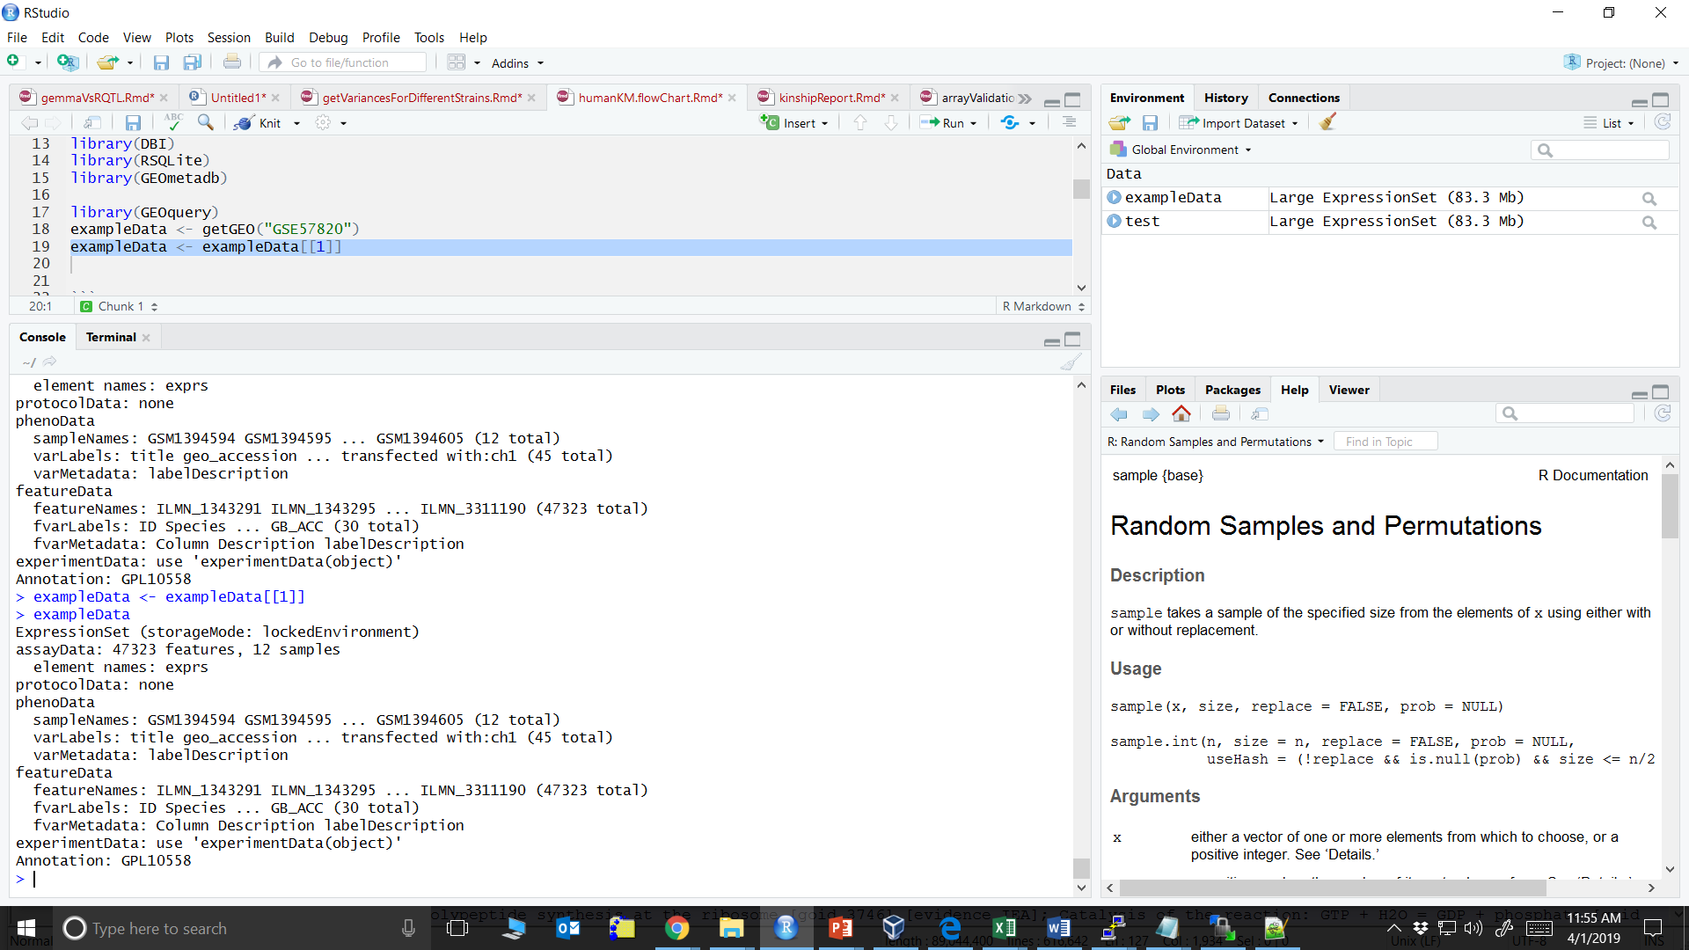
R/GEOquery
library(GEOquery)
exampleData <- getGEO(“/path/file.soft.gz”)

Slide 9
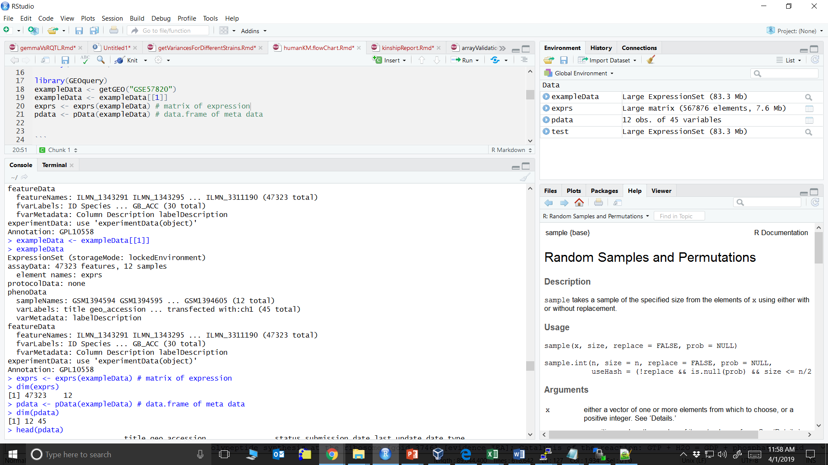
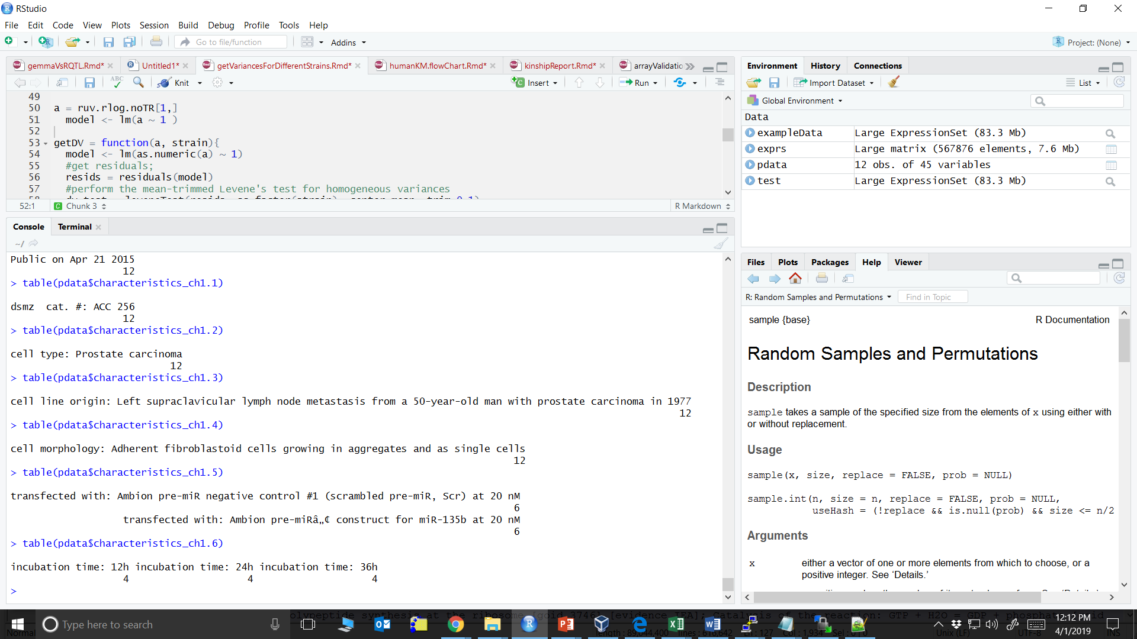
R/GEOquery
47,323 probe sets & 12 samples
45 phenotypes for 12 samples
You can use this data moving forward
CHECK: with the array data you won’t have missing data, but you may have a lot with phenotype data
Names are super detailed and redundant, may want to change before analyses

Slide 10
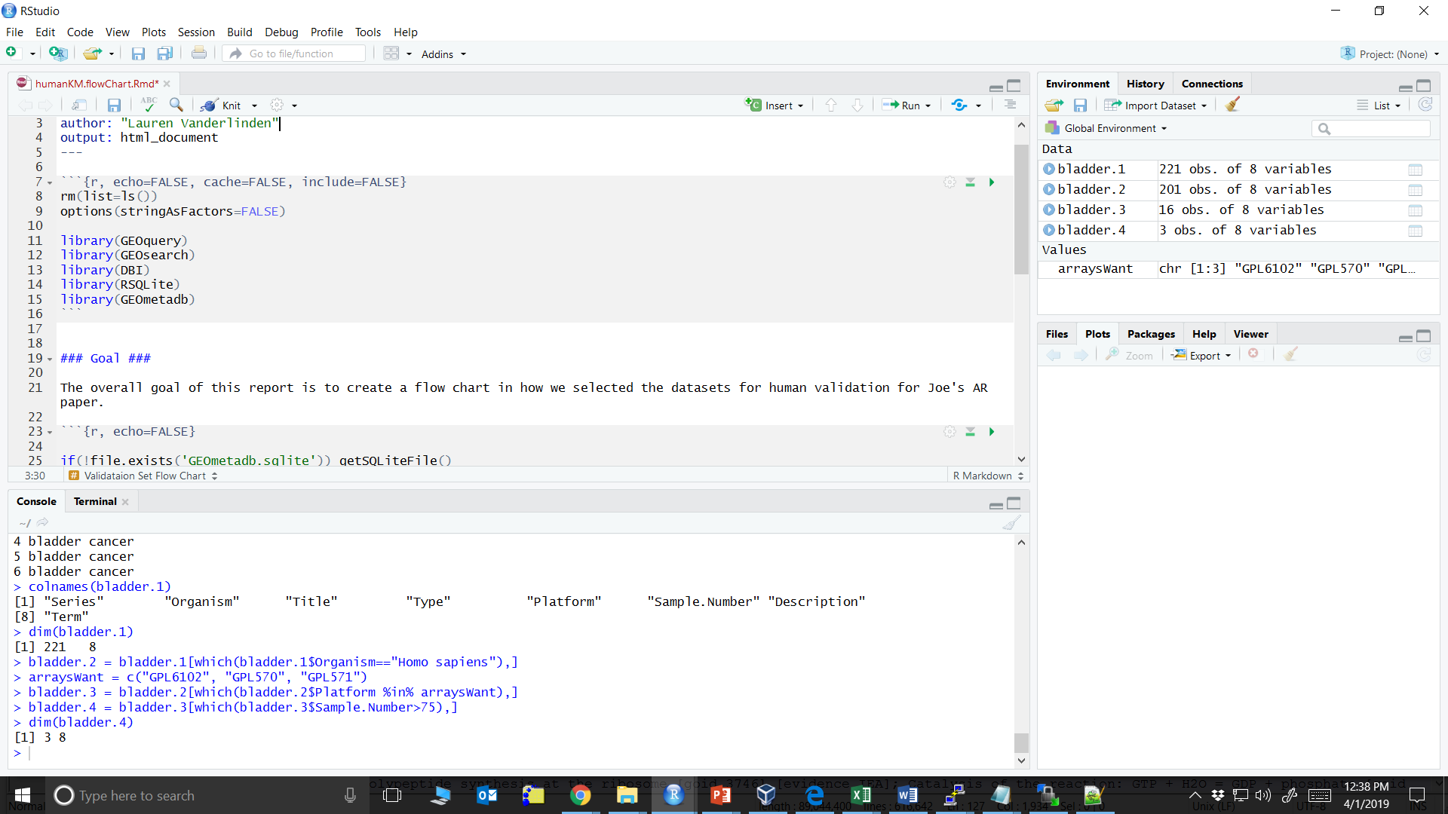
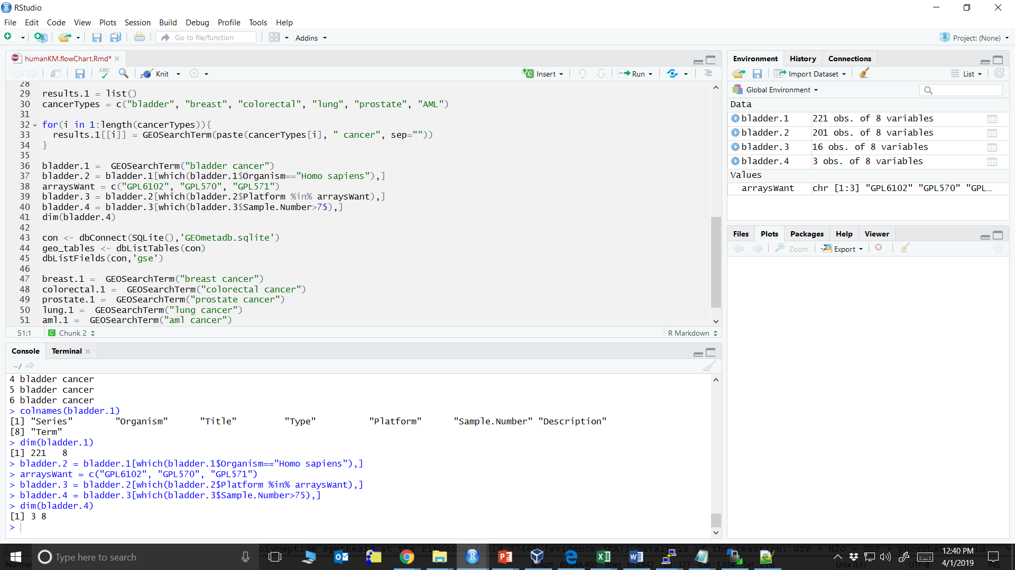
Browsing GEO in R
1. Search “bladder cancer”
3. Only specific array platforms
4. Must have >75 samples
2. Limit to humans
Example Search/Filtering Criteria

Slide 11
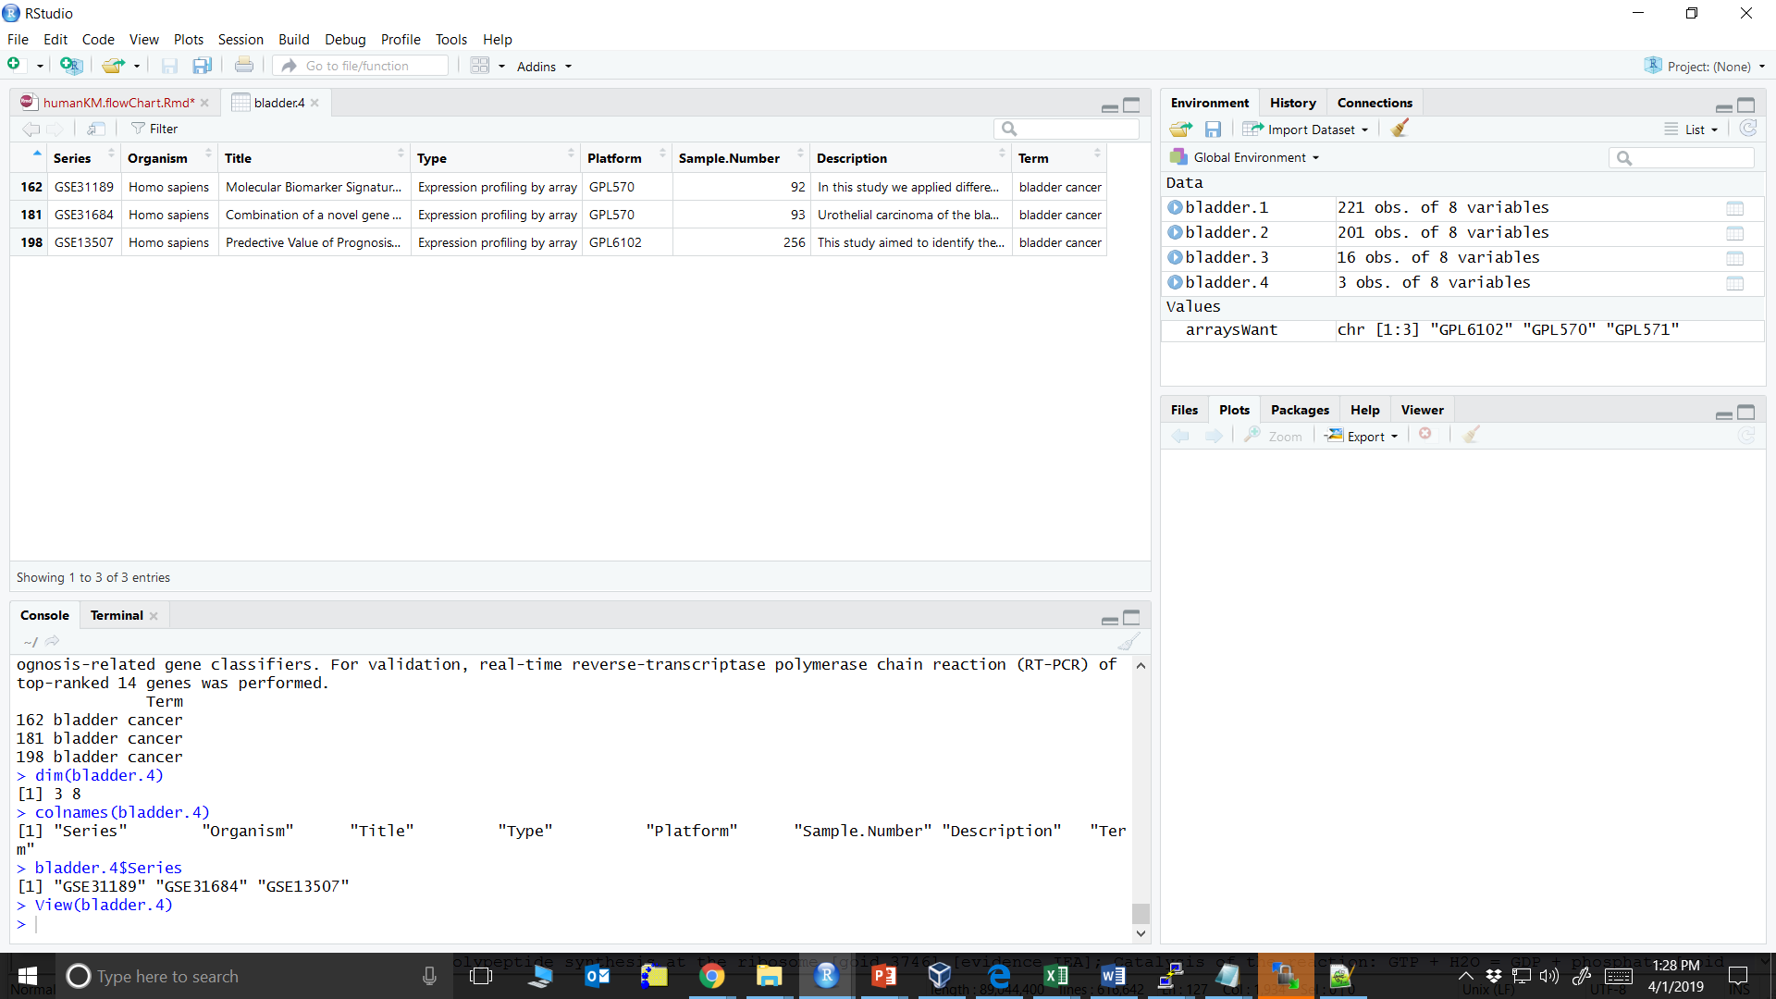
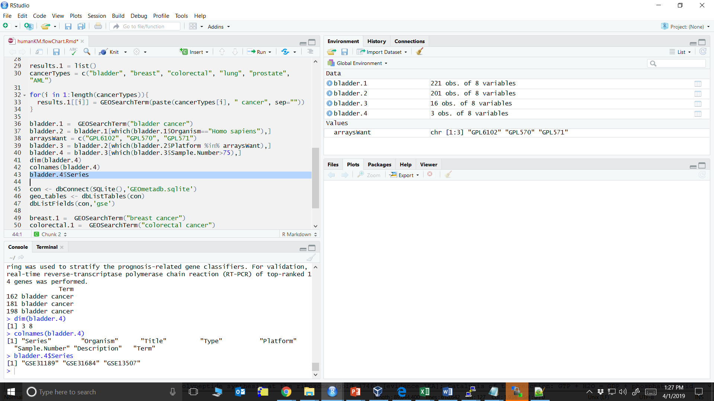
Browsing GEO in R
Once you identify the GEO datasets you want, use getGEO() for analyses

Slide 12
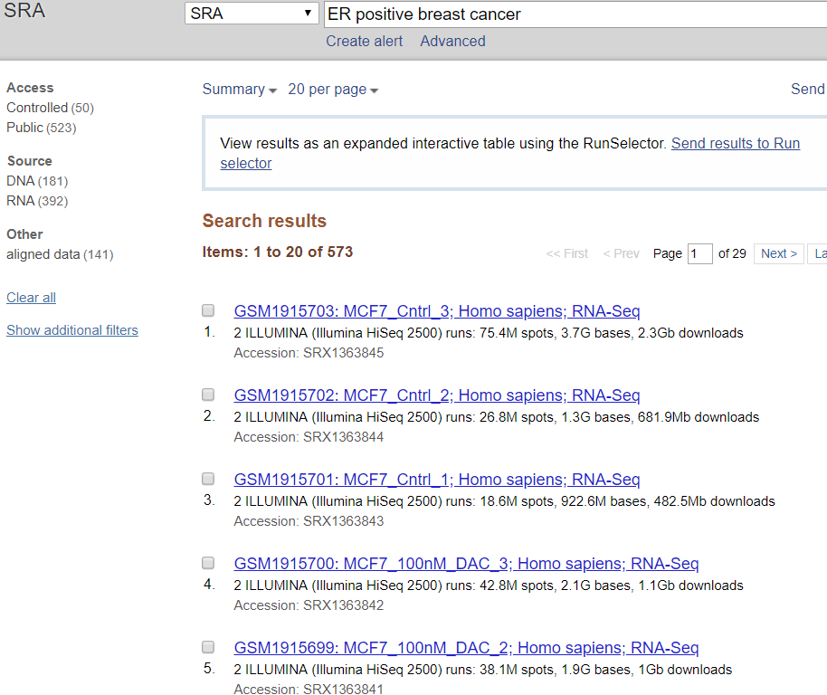
SRA Database
NCBI
Very similar to GEO except this is all sequencing data
RNA-Seq
DNA-Seq
ChIP-Seq
Notice initial search gives sample results

Slide 13
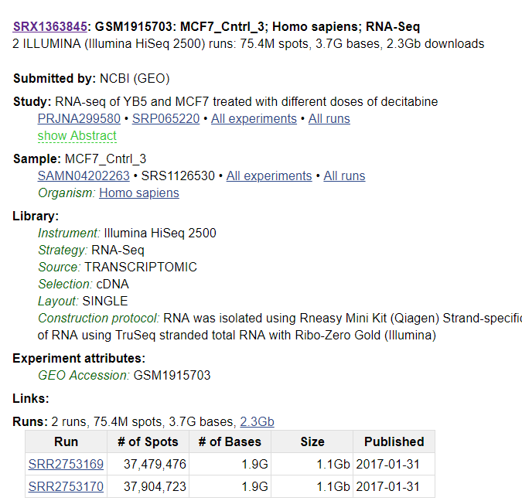
SRA Database
SRR: Individual run in the experiment
SRS: sample information
SRX: experiment level
SRP: project level
Many still linked to GEO

Slide 14
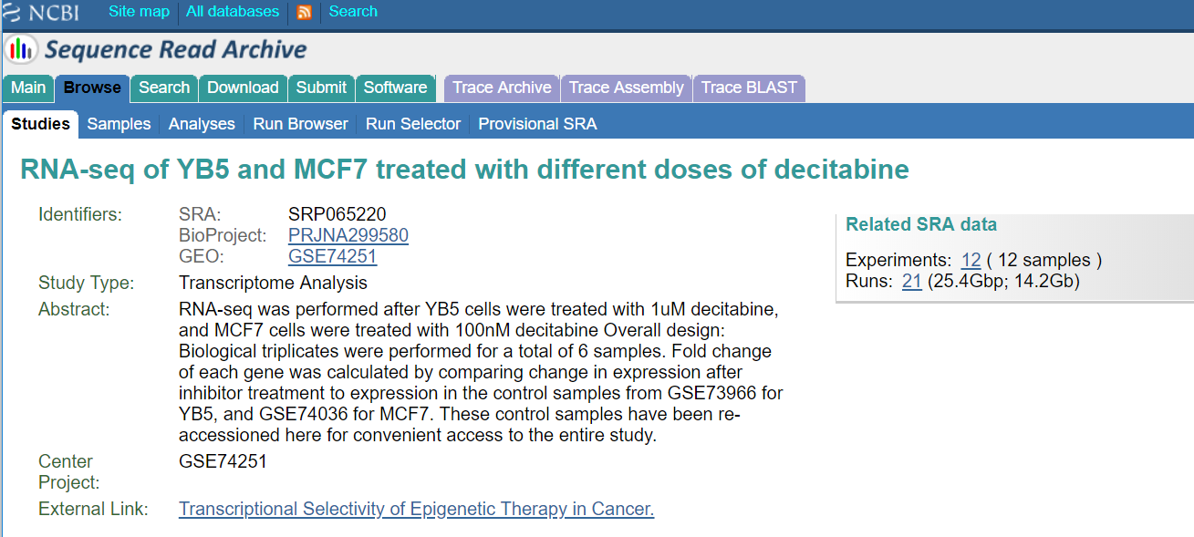
SRA Database

Slide 15
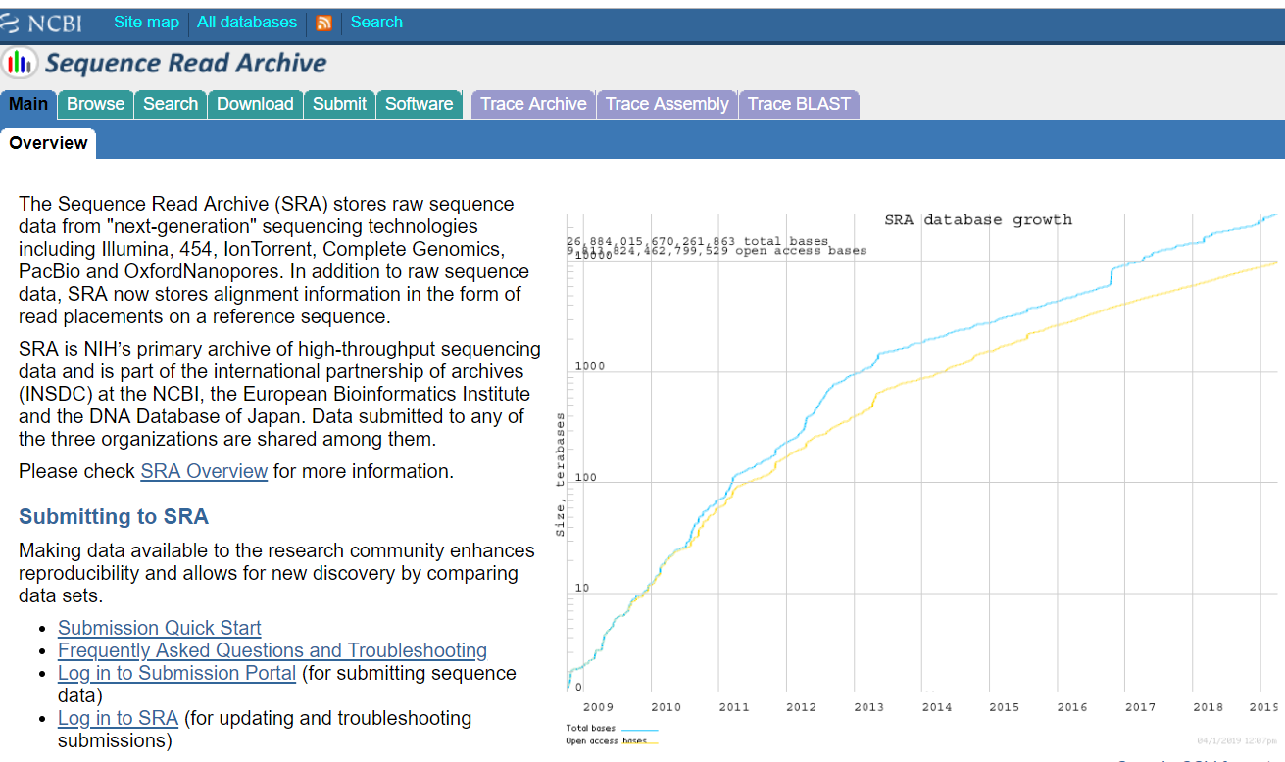

Slide 16
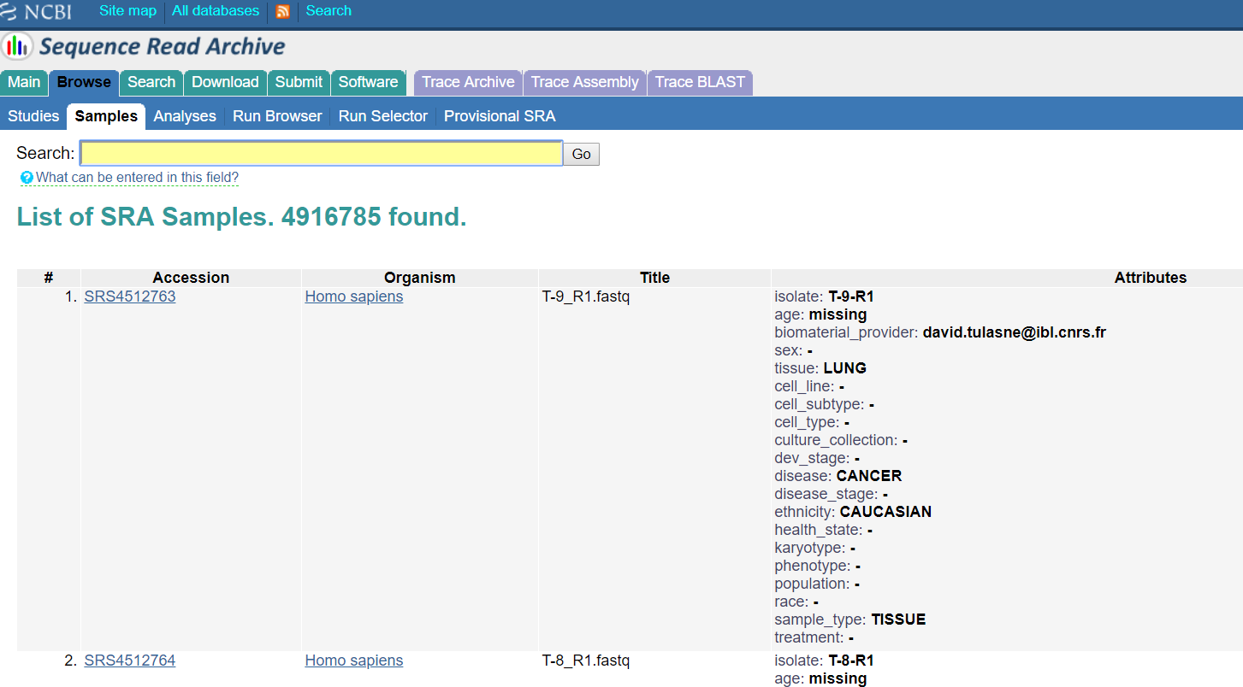

Slide 17
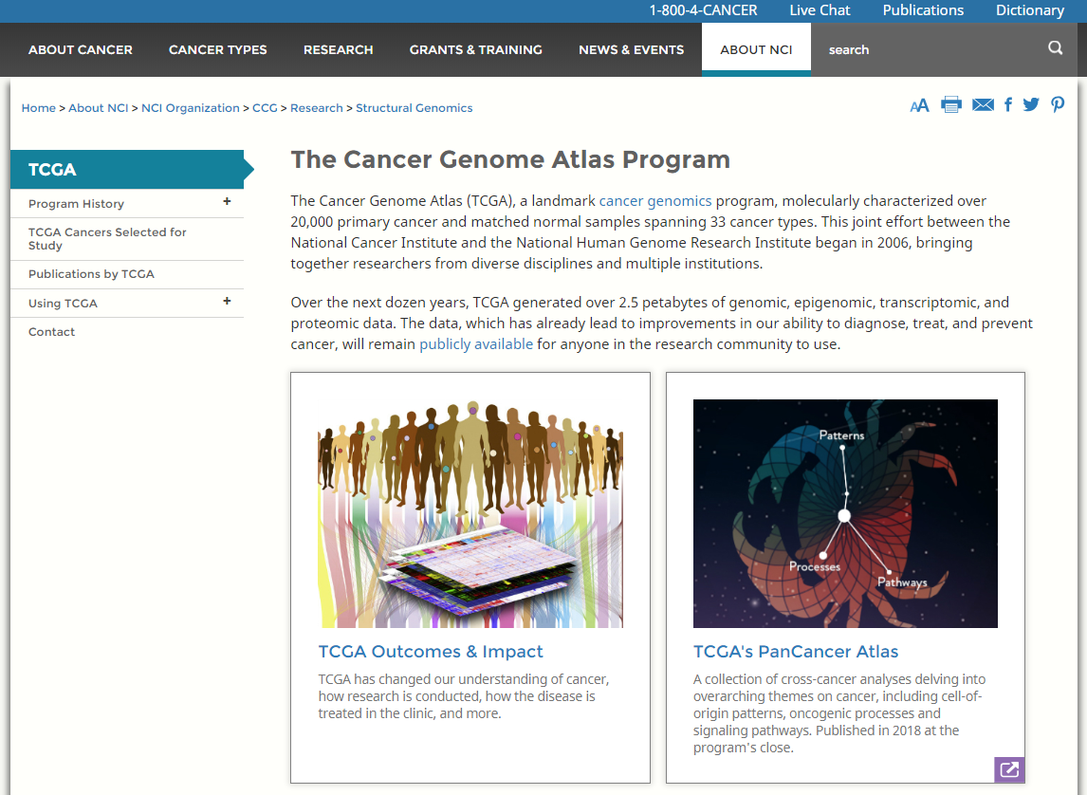
TCGA

Slide 18
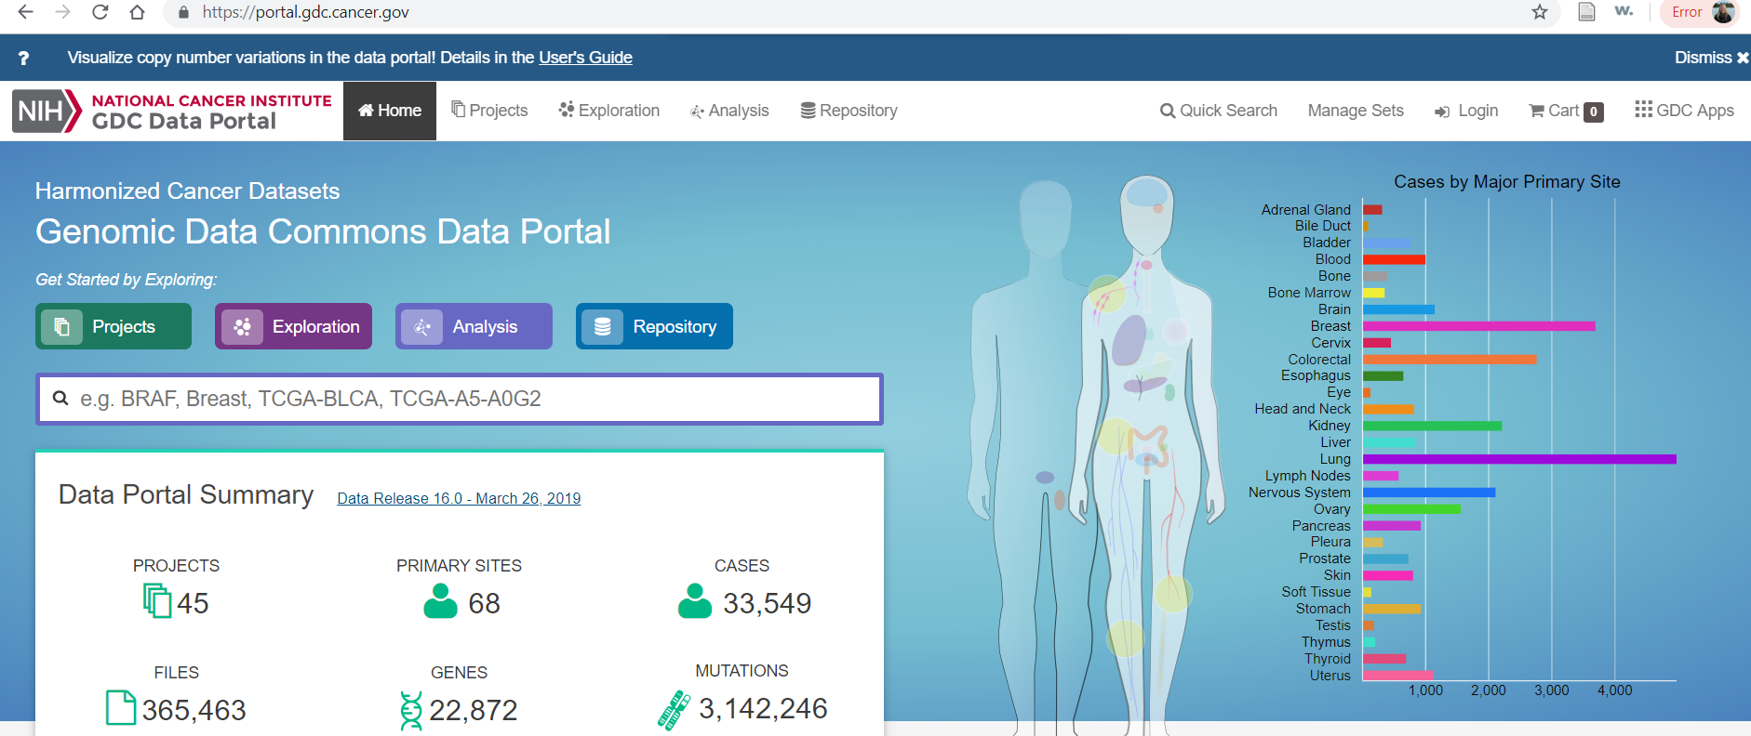
TCGA – Data Portal

Slide 19
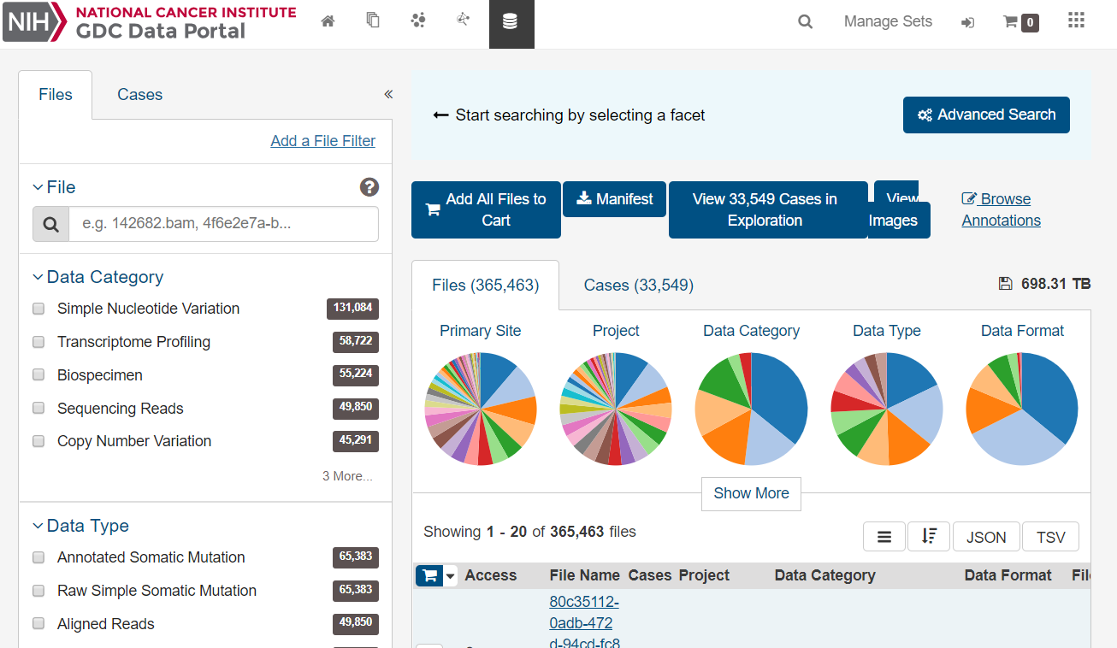

Slide 20
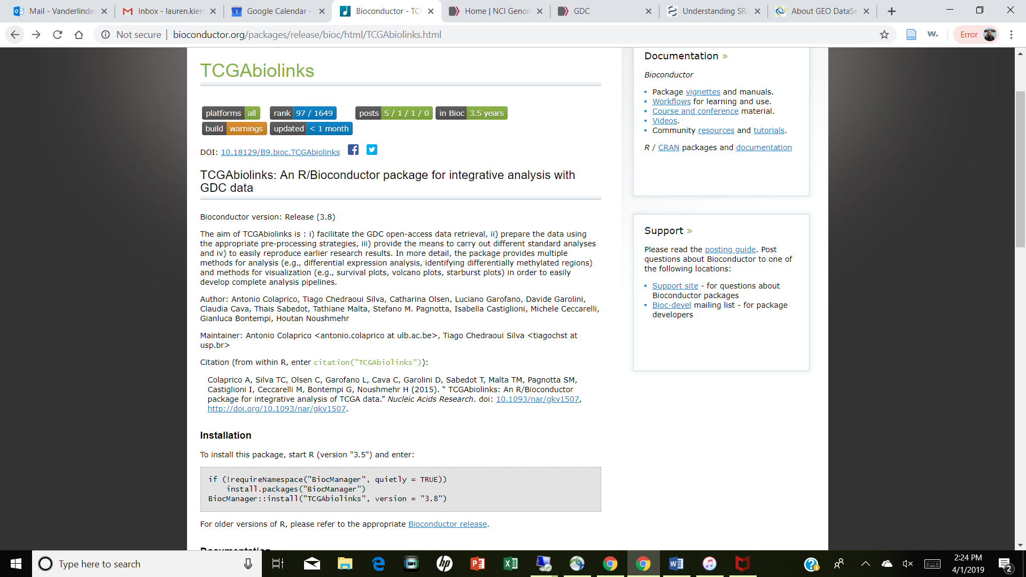
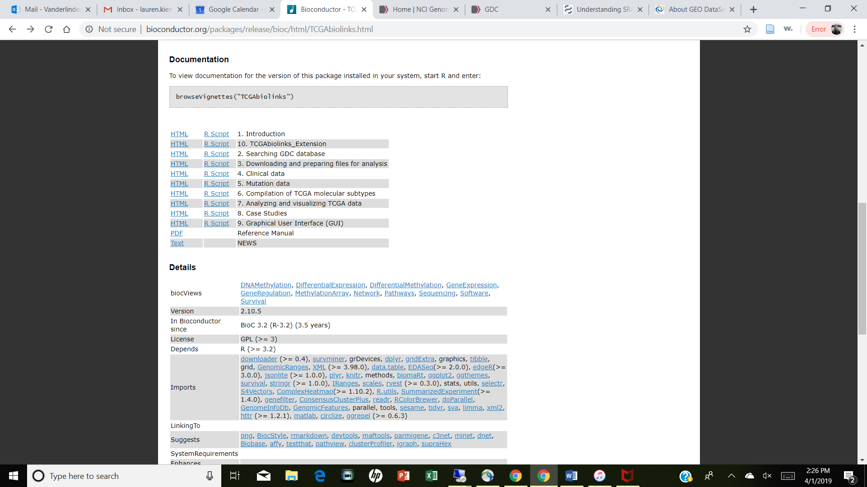
R/TCGAbiolinks
Naming system:
Aliquot barcode: TCGA-G4-6317-02A-11D-2064-05
Participant: TCGA-G4-6317
Sample: TCGA-G4-6317-02

Slide 21
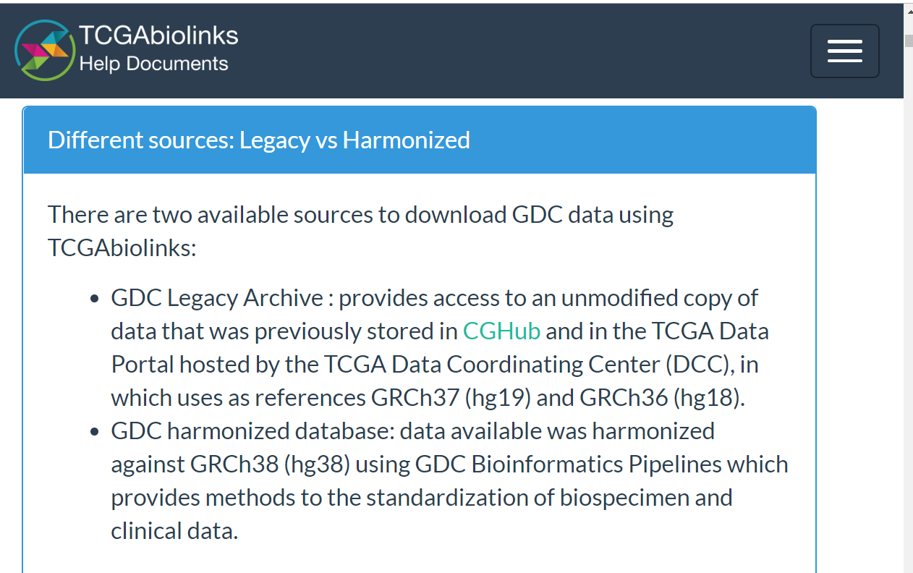
TCGA Legacy
Legacy older genomes (hg19 or hg18)
Harmonized database have standards for specimen and clinical data

Slide 22
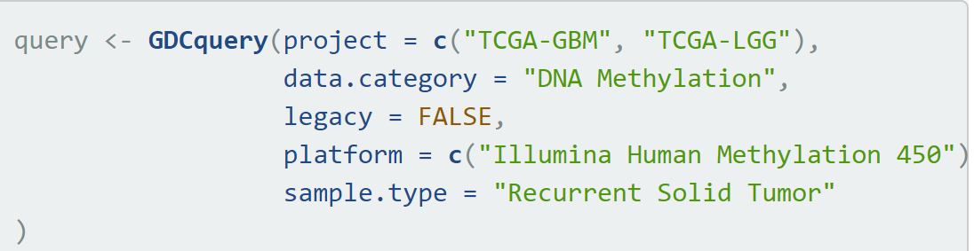
GDCquery()
This is dependent on SQL databases and can be computationally intensive

Slide 23
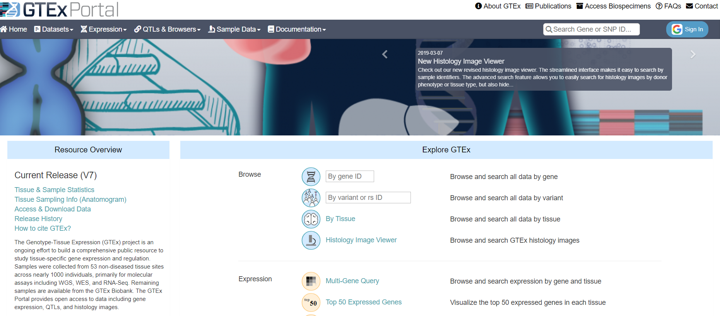
GTEx
https://gtexportal.org/home/
Human tissue information on NON-DISEASED individuals
Post mortem samples
Quantitative Trait Loci (QTL)

Slide 24
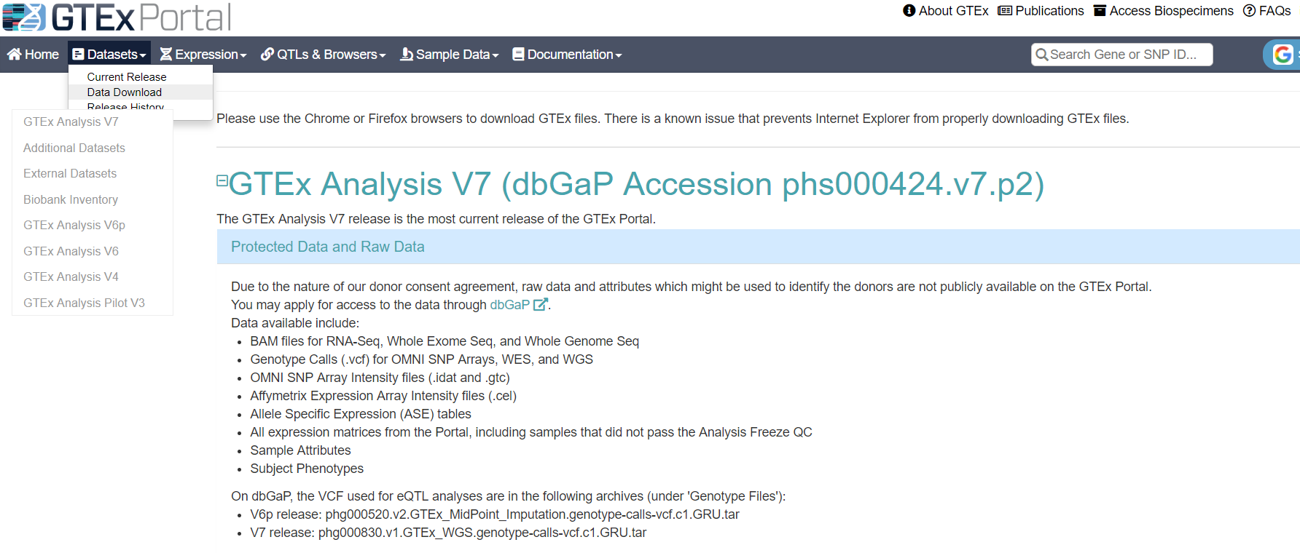
GTEx

Slide 25
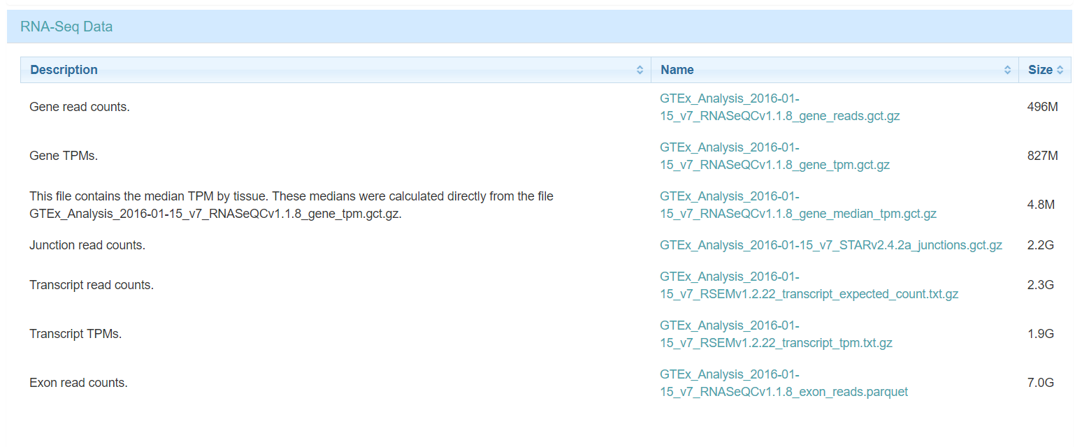
GTEx RNA-Seq Downloads

Slide 26
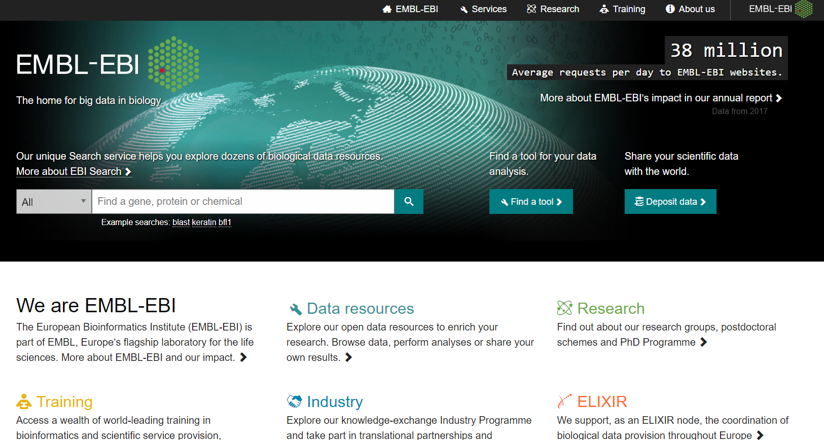
European Bioinformatics Institute
https://www.ebi.ac.uk/

Slide 27
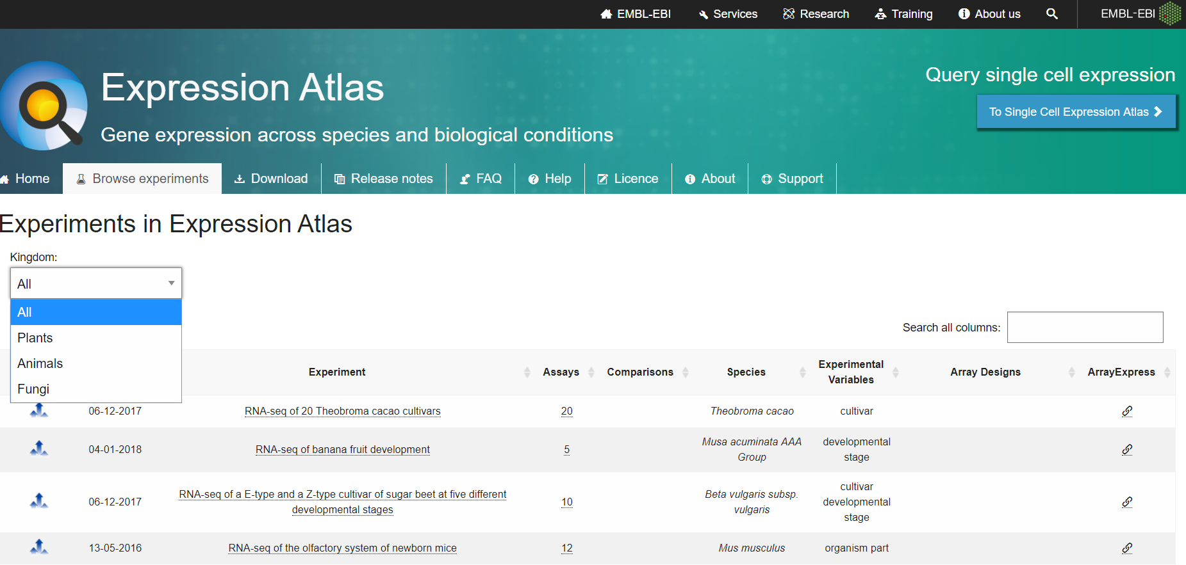
EBI Expression Atlas
Browse and download in R:
R/ExpressionAtlas

Slide 28
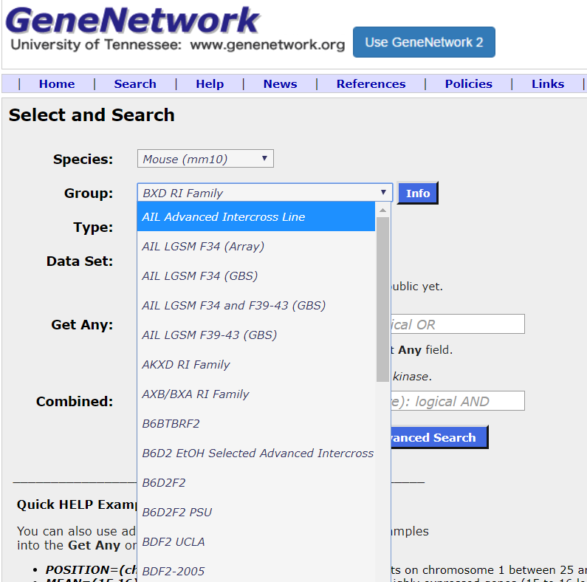
Gene Network
http://www.genenetwork.org
Extensive database on rodents
Group is panel or cohort
Type: Phenotype or Tissue Specific (Adispose)
Dataset: Specific experiment
Get Any and Combined is a way to filter the previous selected fields

Slide 29
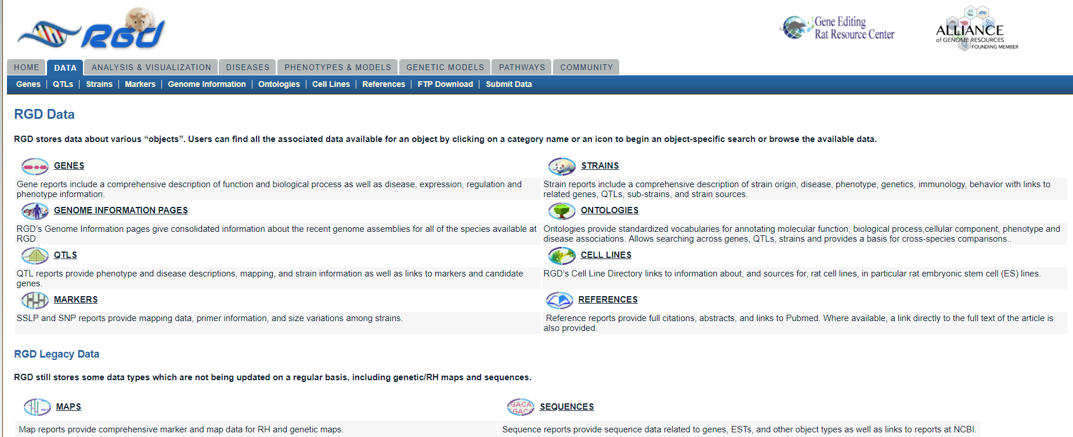
RGD
https://rgd.mcw.edu/wg/data-menu/

Slide 30
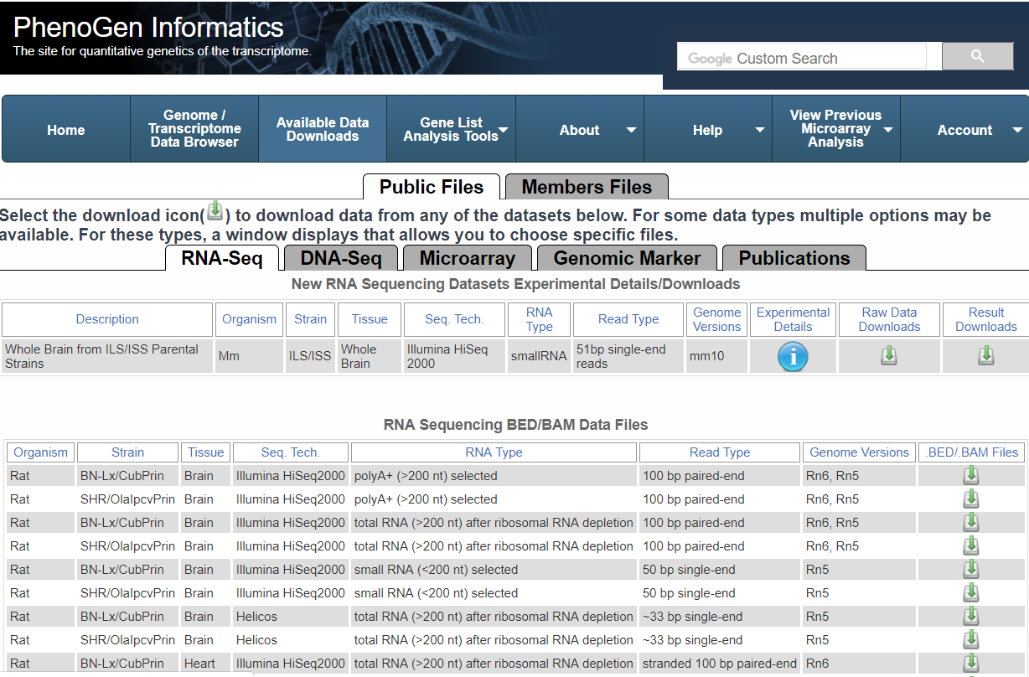
PhenoGen
https://phenogen.org/web/sysbio/resources.jsp

Slide 31
Validation - Gene Signatures
Popular in cell culture and animal models
Do my results translate to in vivo human?
Very common in cancer
Diseased tissue availability
Example:
Differential expression between treatment and placebo in diseased animals
Know treatment helps outcome
List of candidate genes that are differentially expressed
Find a human disease dataset
Perform survival analysis on your “gene signature”

Slide 32
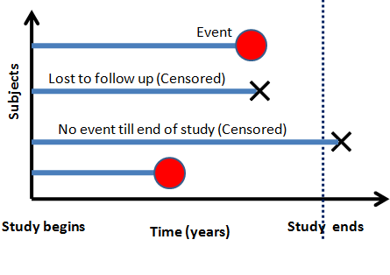
Survival Data
Often used in clinical trials
Outcome variable is the time until the occurrence of an event of interest
Death (overall survival)
Disease specific survival (DSS)
Disease-free survival
Progression-free survival
Metastasis-free survival
Censored data
Source: alphabeta statistics

Slide 33
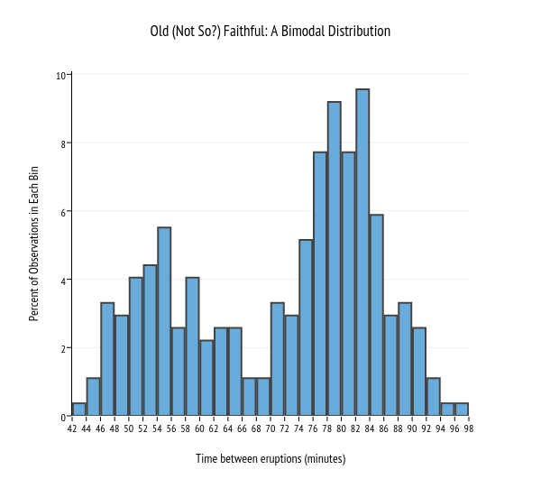
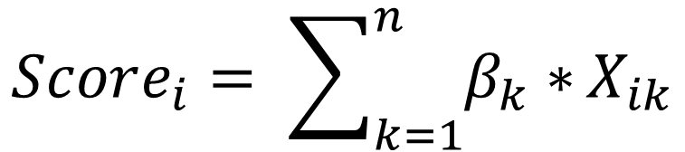
Creating a Gene Signature
$$h_{i}\left(t\right)= h_{0}\left(t\right)e^{\left\{β_{1}X_{i1}+ …. + β_{k}X_{ik}\right\}}$$
For each gene, perform a cox proportional hazard model and obtain resulting coefficient.
Calculate a score for each subject by summing gene*βcoefficient.
Classify each subject as having a high/low signature by determining if individuals score is above/below median score value.
Perform cox proportional hazard on high/low signature classification.
Baseline hazard function
Linear function of set of predictors
$$Score_{i}= \sum_{k=1}^{n}{β_{k}∗}X_{ik}$$

Slide 34
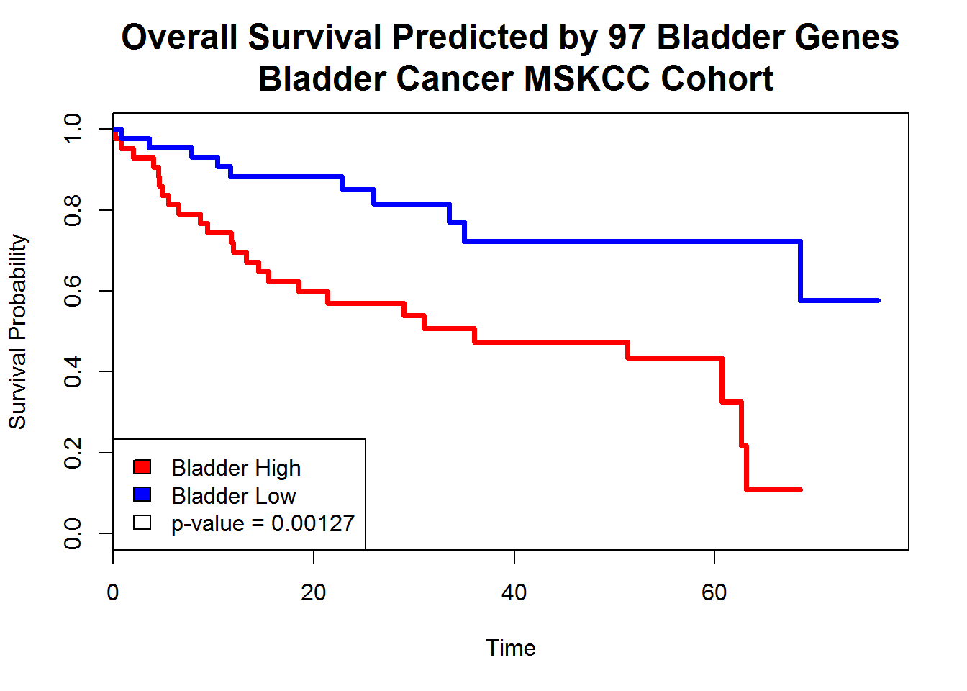
Testing Gene Signature
Results from your cox proportional hazard model
Visualize using a Kaplan-Meier (KM) plot
My list of candidate genes predicts survival in a bladder cancer cohort

Slide 35
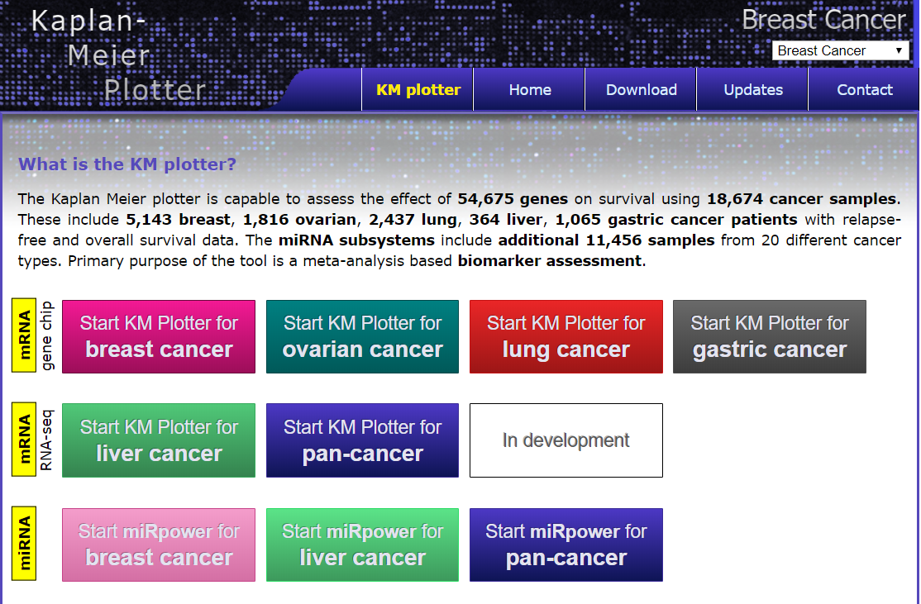
KM Plotter
http://kmplot.com/analysis/

Slide 36
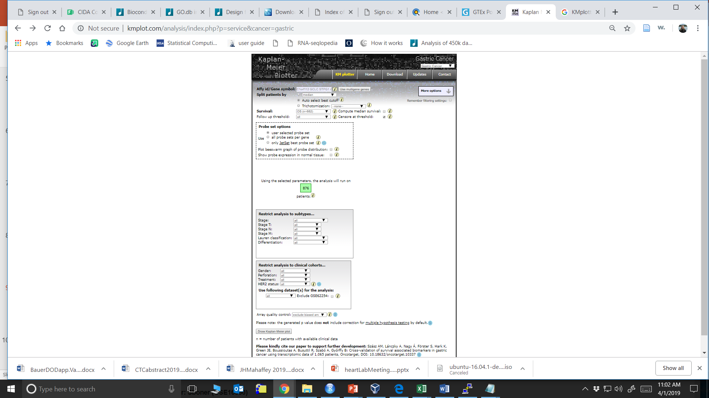
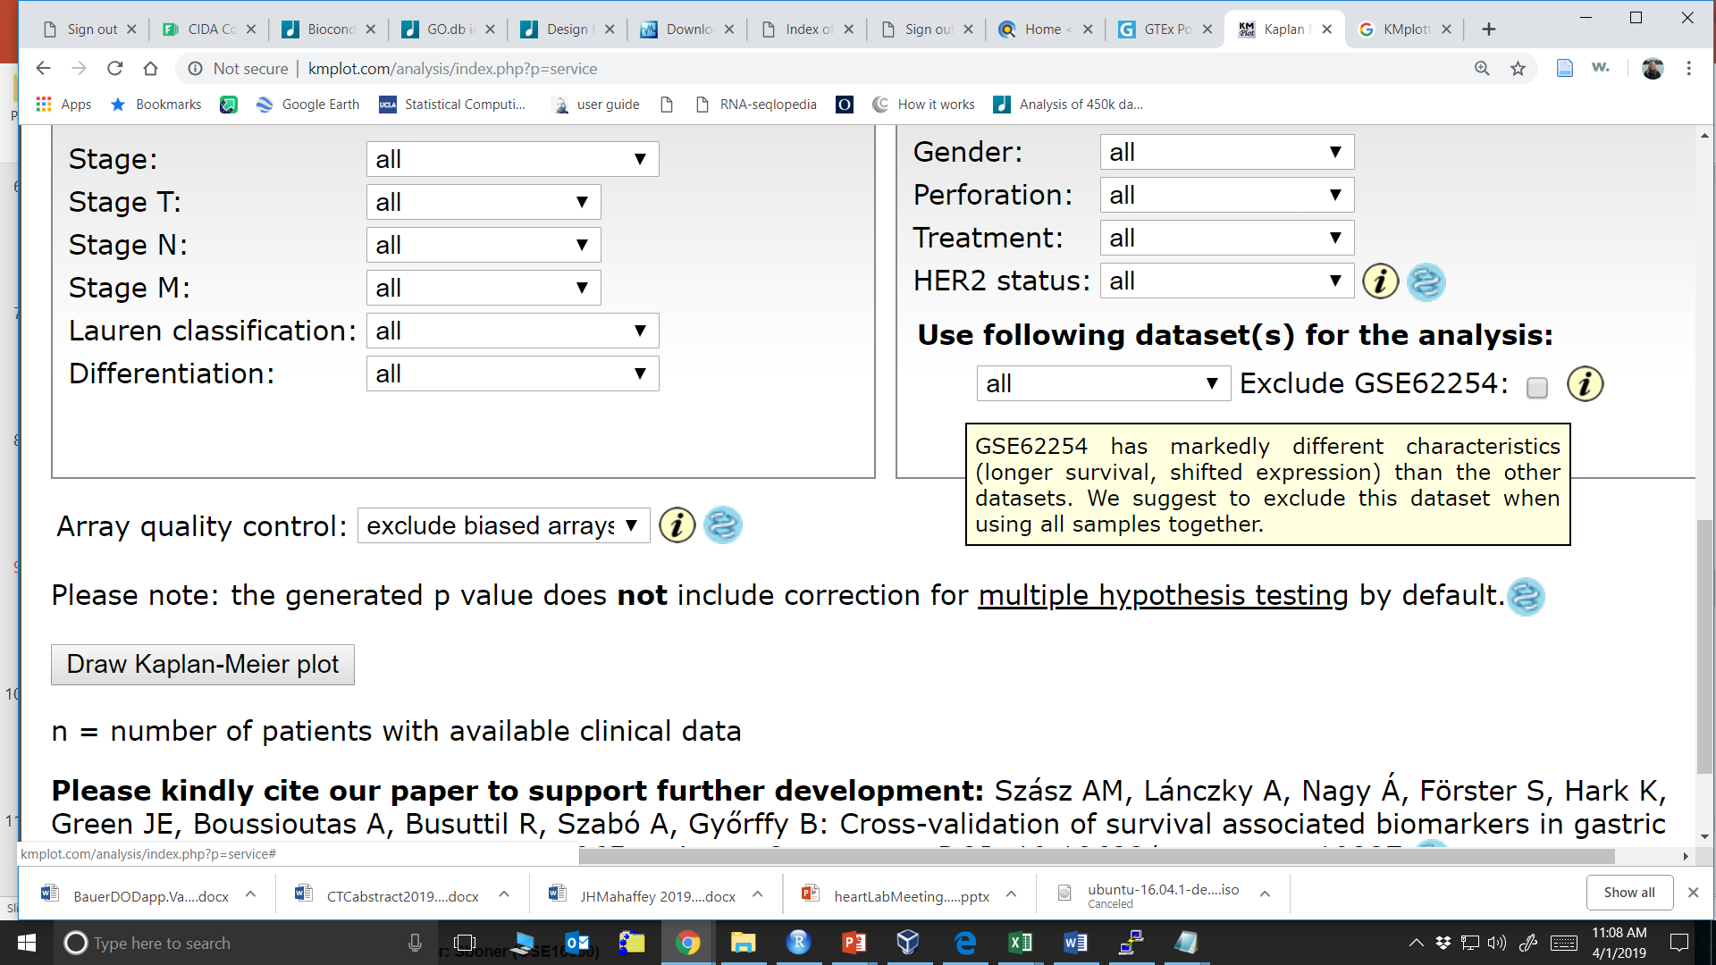
KM Plotter – Selecting Data for Analysis

Slide 37
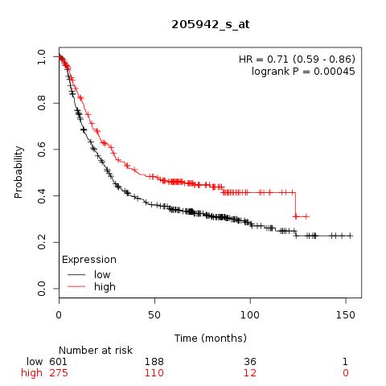

KM Plotter - Results

Slide 38


Gene Signature R Code

Slide 39

Gene Signature R Code

Slide 40


Gene Signature R Code
Beware of having large number of genes in your candidate list
KMplots won’t take more than 65 genes

Slide 41
References
http://www.karlin.mff.cuni.cz/~pesta/NMFM404/survival.html

